Slide 1
Track II
Distributed-Memory Parallel Programming
2025 IHPCSS
Lisbon, Portugal

Slide 2








Track 2 Team
Andrew Kirby Instructor
University of Wyoming, USA

Slide 3
Track 2 Team
John Cazes Hands-On Helper
Texas Advanced Computing Center, USA

Slide 4
Track 2 Team
Erik Draeger Hands-On Helper
LLNL, USA

Slide 5
Track 2 Team
Sebastian Kuckuk Hands-On Helper
NHR@FAU, Germany

Slide 6
Track 2 Team
Erwin Laure Session Chair, Day 2
Max Planck Computing & Data Center, Germany

Slide 7
Track 2 Team
Ramses van Zon Session Chair, Day 2
SciNet, University of Toronto, Canada

Slide 8
Track 2 Team
Matthais Brust Evaluator
University of Luxembourg

Slide 9
Track 2 Team
Julie Wernert Evaluator
Indiana University, USA

Slide 10


Lecture Content Inspiration
Ludovic Capelli
David Henty
EPCC Archer Tutorials SC17 MPI Tutorial
https://web.cels.anl.gov/~thakur/sc17-mpi-tutorial/

Slide 11

Track overview
M P I
Section I – Intro MPI Review
Section II - Derived Data Types
Section III – Virtual Topologies
Section IV – Neighborhood Collectives
Section V – Hybrid Programming MPI+X
M P I
M P I
M P I
M P I

Slide 12
Track AIMS
M P I
A Practical Course
Understand the message-passing model for parallel programming
Write parallel programs in C, Fortran, or Python using the MPI library
Though Interactive Hands-On Examples
M P I
M P I
M P I
M P I

Slide 13
Timetable
Designed as 30-minute blocks
20 minutes of teaching
10 minutes of practice

Slide 14

Distributed Memory = ?

Slide 15
Bridges Setup (i)
Connecting ssh <username>@bridges2.psc.edu
Clone Repo (exercises + slides) git clone https://github.com/ackirby88/IHPCSS2025-mpi
Interactive Reservations
./interactive8-day1.sh
./interactive8-day2.sh

Slide 16
Bridges Setup (ii)
# (1) First time you log into bridges2
[user@bridges2-login01 ~]$ module load python anaconda3 cuda intel-mpi
[user@bridges2-login01 ~]$ module list
[user@bridges2-login01 ~]$ module save mpi-track
[~]$ module list Currently Loaded Modules: 1) allocations/1.0 2) psc.allocations.user/1.0 3) intel-mpi/2021.10.0 4) python/3.8.6 5) anaconda3/2024.10-1 6) cuda/12.6.1
# (2) Next time you log into bridges2
[~]$ module restore mpi-track

Slide 17
Bridges – Running on the Login Node (C/F90)
Go to the repository
Compile the code (c/f90)
Run the executable
cd <repo>/exercises/Exercise.0-Preamble/<lang>/
make
./mpi_hello_world
Repo: https://github.com/ackirby88/IHPCSS2025-mpi

Slide 18
Bridges – Running on the Login Node (Python)
Go to the repository
Python Environment Setup
Run the executable
cd <repo>/exercises/Exercise.0-Preamble/python/
source 0_source_me_first.sh
python 1_hello_mpi.py
Repo: https://github.com/ackirby88/IHPCSS2025-mpi

Slide 19
Distributed-Memory Parallel Computing
Motivation

Slide 20
Clock Frequency
1998 First 0.1GHz CPU, Pentium II Xeon 400.
1999 First 1GHz CPU, AMD Athlon.
2001 First 2GHz CPU, Intel Pentium 4.
2002 First 3GHz CPU, Intel Pentium 4.
2012 First 4GHz CPU, AMD FX-4170.
2013 First 5GHz CPU, AMD FX-9590.
2023 First 6GHz CPU, Intel Core i9-13900KS.

Slide 21
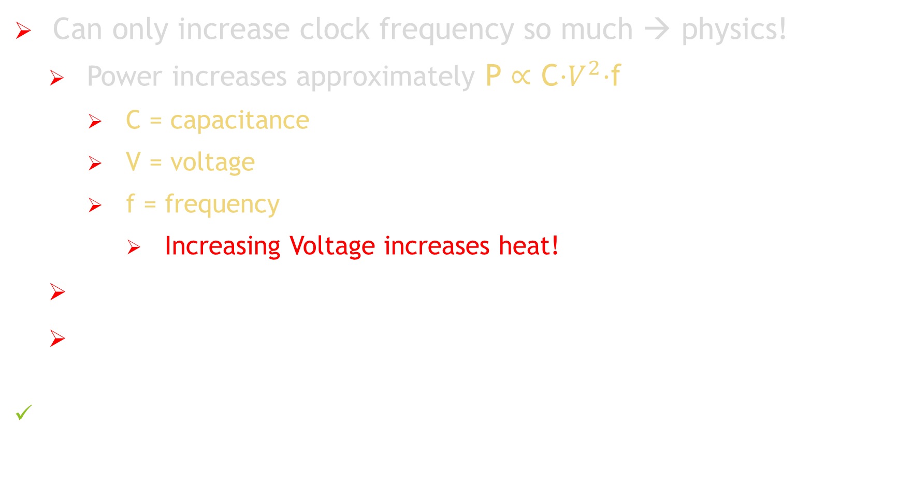
Need for Parallel Computing
Can only increase clock frequency so much → physics!
Power increases approximately P ∝ C⋅$V^{2}$⋅f
C = capacitance
V = voltage
f = frequency
Increasing Voltage increases heat!
Signal Propagation Delay (speed of light)
Quantum Effects and Material Limits
Instead of trying to increase clock frequency, why not use multiple cores?

Slide 22
Dawn of Parallel Computing
Early Parallel computing traces its roots back to the 1940s and 1950s
1950s–60s: Concepts of vector and array processing emerged
1970s: Parallel architectures like SIMD (Single Instruction, Multiple Data) -- ILLIAC IV (1966) MIMD (Multiple Instruction, Multiple Data) -- Gamma 60 (1957)
1980s: Rise of Distributed-Memory Systems
Early Message Passing Libraries (vendor-specific)
e.g., PVM, Express, and NX
1990s: The Emergence of the Message-Passing Interface (MPI)
Portable, standardized interface for message passing

Slide 23
Message Passing Interface (MPI) history
1992 MPI Forum formed
1994 MPI-1 - pt2pt, collective operations, communicators
1997-2003 MPI-2 - One-sided communication (RMA), parallel I/O
2012 MPI-3 - Improved RMA, non-blocking collectives, enhanced MPI+X
2021 MPI-4 - Better support for GPU-aware MPI - Partitioned communication for better overlap of comm & computation
2025 MPI-5 - Standard Application Binary Interface (ABI) - And more!

Slide 24
M P I
The MPI Library is the most important piece of software in parallel programming.
All of the world’s largest supercomputers are programmed using MPI.
Writing parallel programs using MPI is fun!

Slide 25
Section I
Intro MPI Review

Slide 26
Programming Models
Message-Passing Parallel Programming
Serial Programming
Concepts
Arrays Subroutines
Control Flow
Variables
Human-Readable
Object-Oriented
Concepts
Processes
Send/Recv
SPMD
Collectives Groups
Communicators
Languages
Python Julia
C/C++ Fortran
struct
if/then/else
Libraries
MPI
MPI_Init()
Implementations
gcc icc
gfortran javac
crayftn nvcc
Implementations
Intel MPI MPICH2
OpenMPI Cray MPI
IBM MPI

Slide 27
Message Passing Model
Processes Message Passing based on notion of processes. i.e., an instance of the program, together with the program’s data
Parallelism Many processes co-operating on same task.
Private Data Each process has access only to its OWN data.
Communication Processes sending & receiving messages.

Slide 28
Sequential Paradigm
Memory (M)
Process
Processor (P)

Slide 29
Parallel Paradigm
Processes
0
1
2
3
M
M
M
M
P
P
P
P
Message Passing Interface
Communication Network

Slide 30

Cluster of Workstations
Aim to run a single computation across all workstations.

Slide 31
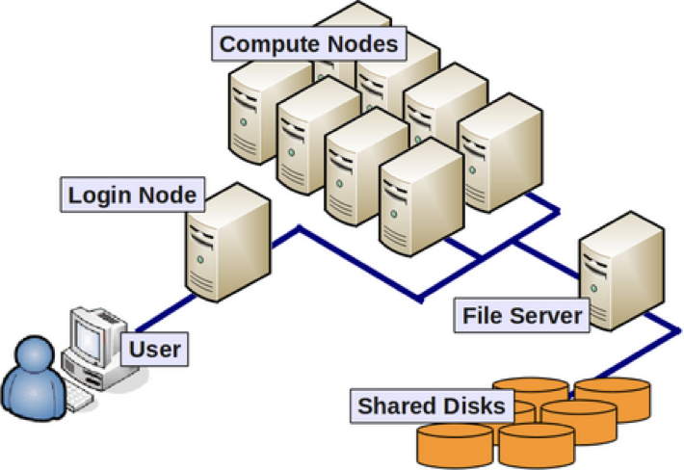
“Supercomputer” Architecture
Log Nodes
Compute Nodes Each contains:
CPU(s) w/ DRAM
GPU(s) w/ VRAM
Interconnect switch

Slide 32
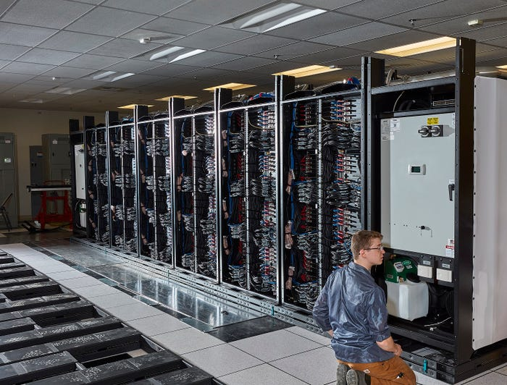

Distributed-Memory Architectures
M
P
M
P
M
Inter-connect
P
M
M
P
P
M
P

Slide 33
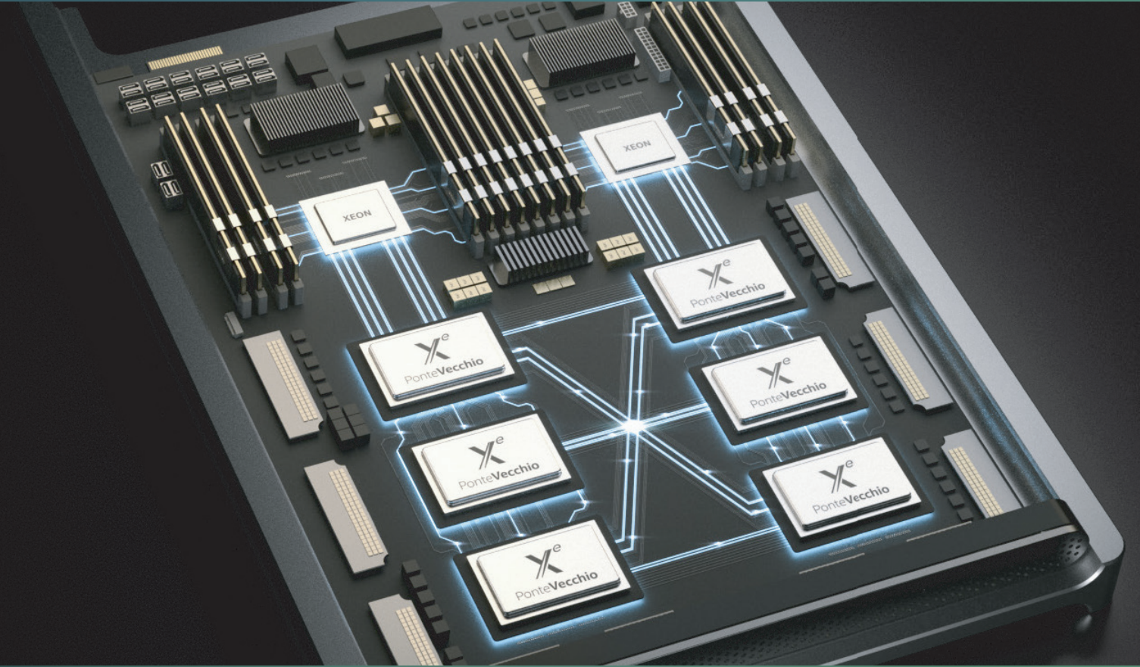
Distributed-Memory Architectures
M
P
M
CPU
P
M
Inter-connect
CPU
P
GPU
M
GPU
GPU
M
P
P
GPU
GPU
M
GPU
P

Slide 34
SPMD
SPMD Most message passing programs use the Single-Program-Multiple-Data (SPMD) model.
Program All processes run (their own copy of) the same program.
Data Each process has a separate copy of the data.
Process ID To be useful, each process has a unique identifier.
Path Processes can follow different control paths, based on their process ID.
Partitioning Usually run one process per processor/core/GPU.

Slide 35


Distributed-Memory Processing
mpirun –np 4 ./myApp <args>
M P I
M P I
int x;
int y;
M P I
M P I
M P I

Slide 36







Distributed-Memory Processing
mpirun –np 4 ./myApp <args>
int x;
int y;
int x;
int y;
int x;
int y;
int x;
int y;
int x;
int y;
myApp
myApp
myApp
myApp
0
Rank
Rank
Rank
Rank

Slide 37
Distributed-Memory Processing
X = 0;
int x;
int y;
int x;
int y;
X = 0;
>> x = 0;
>> x = 0;
if(rank==0) x = 1;
if(rank==0) x = 1;
myApp
myApp
>> x = 0;
>> x = 1;
0
Rank
Rank

Slide 38
MPI is SIMPLE
Many parallel programs can be written using six functions:
Setup
Teardown
Who am I?
How many of us?
Message Passing
MPI_Init
MPI_Finalize
MPI_Comm_rank
MPI_Comm_size
MPI_Send
MPI_Recv

Slide 39
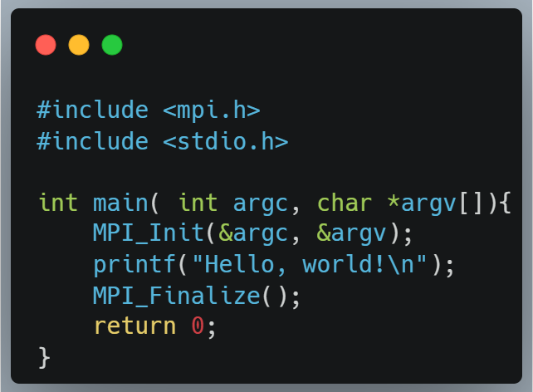
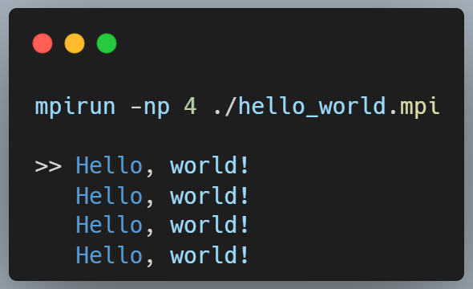
Minimal MPI Program – Hello World!

Slide 40
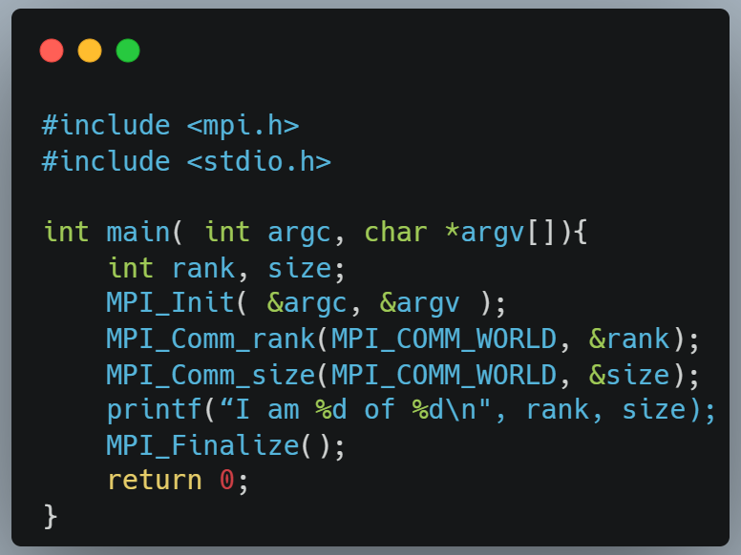
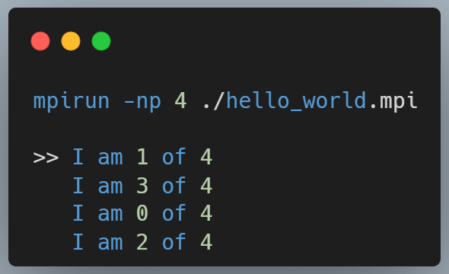
Minimal MPI Program – Better Hello World!

Slide 41
Communicators
All MPI communications take place within a communicator
A communicator is fundamentally a group of processes
There is a pre-defined comm: MPI_COMM_WORLD
Contains ALL processes
A message can ONLY be received within the same communicator from which it was sent

Slide 42
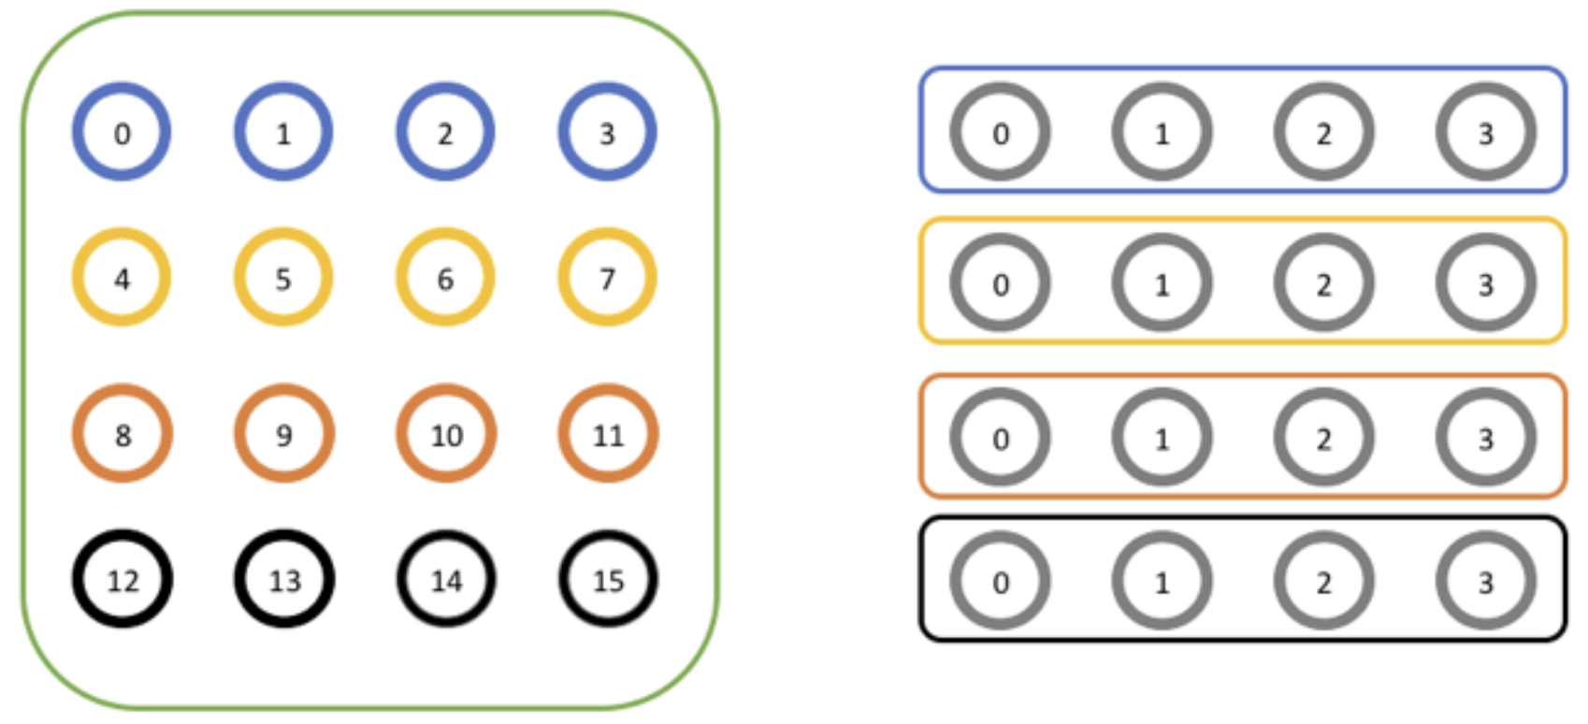
Use of Communicators
Split MPI_COMM_WORLD into pieces
Each process has a new rank within each sub-communicator
Guarantees messages from the pieces do not interact

Slide 43
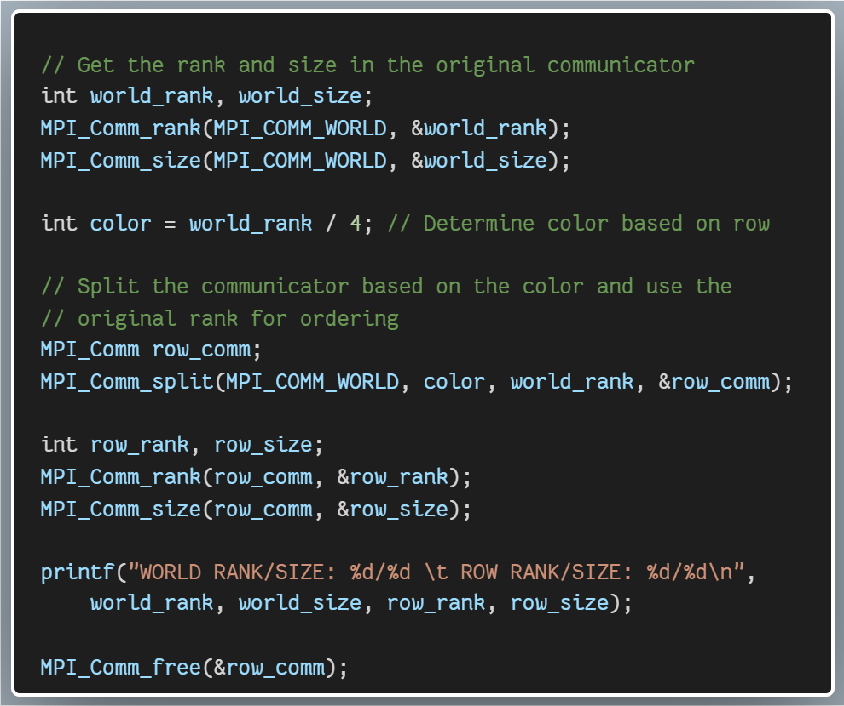
Use of Communicators
int MPI_Comm_split

Slide 44
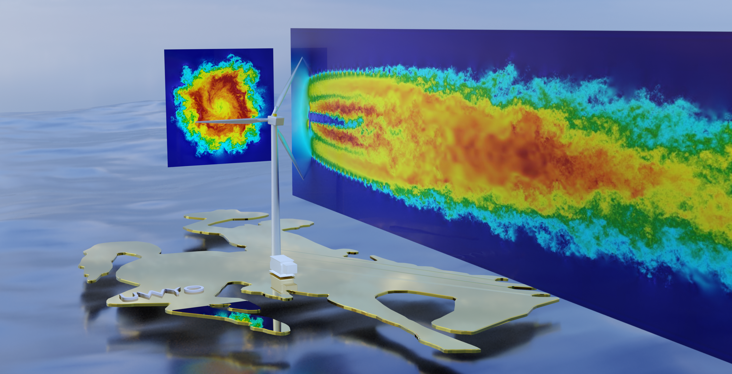
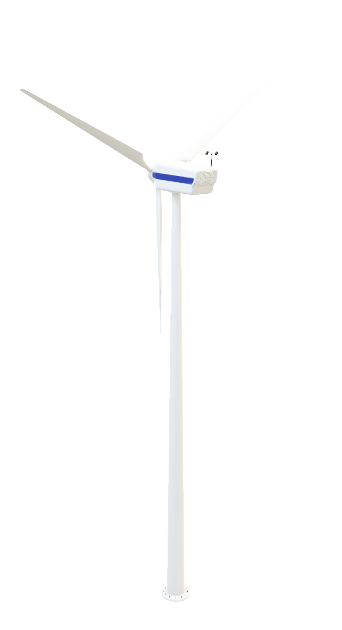
M P I
M P I
M P I
M P I

Slide 45
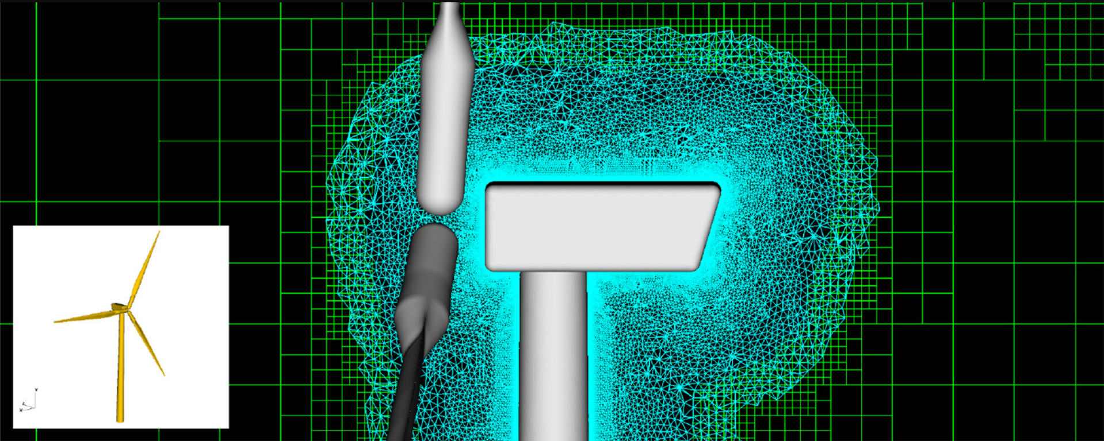
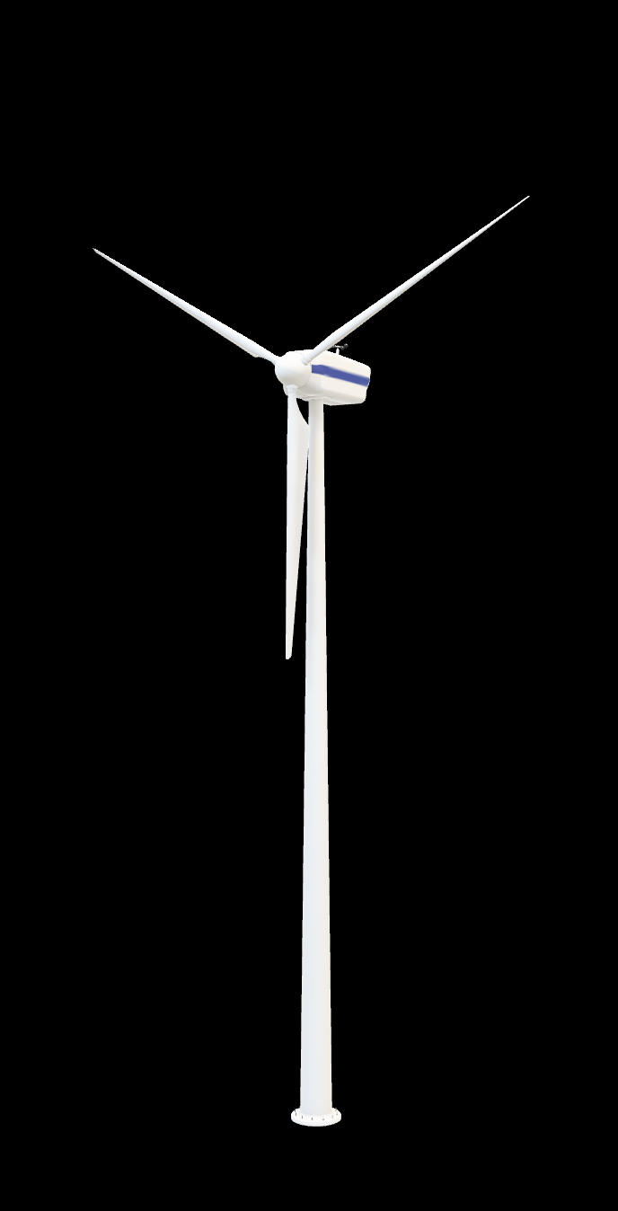
Nonuniform Meshes / MPI SUBGROUPS
M P I
M P I
M P I
M P I
M P I
DG4EST
NSU3D

Slide 46
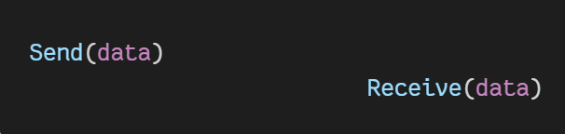
Point-to-point Communications
MPI requires explicit data movement
YOU, the programmer, must say exactly what data goes where and when.
Cooperative data exchange
Data is explicitly sent by one process and explicitly received by another process.
Process 0
Process 1

Slide 47
Messages
Transfer A message transfers a number of data items of a certain type from the memory of one process to the memory of another process.
Contents A message usually contains…
ID of the sending process (in the communicator below)
ID of the receiving process (in the communicator below)
Type of the data items
Number of data items
Data itself (i.e., beginning memory address)
Message identifier (i.e., tag)
Communicator (i.e., comm. context for group of processes)

Slide 48
Communication Modes
Synchronous Send is not complete until the message has started to be received.
Asynchronous Send completes as soon as the message has gone.
Receives are usually synchronous – the receiving process must wait until the message arrives.
// Blocking synchronous send
int MPI_Ssend(const void *buf, int count, MPI_Datatype datatype,
int dest, int tag, MPI_Comm comm);
// Basic send with user-provided buffering
MPI_Buffer_attach(buffer, n*sizeof(double) + MPI_BSEND_OVERHEAD);
int MPI_Bsend(const void *buf, int count, MPI_Datatype datatype,
int dest, int tag, MPI_Comm comm);
// Blocking receive for a message
int MPI_Recv(void *buf, int count, MPI_Datatype datatype,
int source, int tag, MPI_Comm comm, MPI_Status *status);

Slide 49
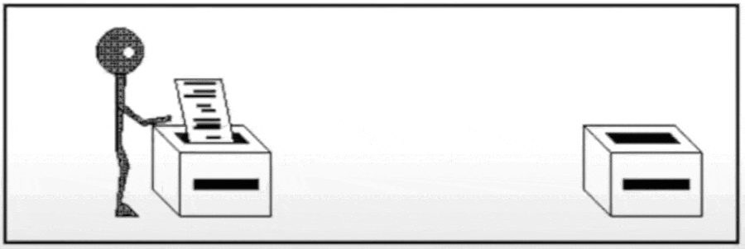
Synchronous Send
int MPI_Ssend
Analogous to faxing a letter or making a phone call.
“Beep” indicates when the letter started to be received.

Slide 50

Asynchronous Send
int MPI_Bsend
Analogous to mailing a letter.
Only know when the letter has been posted, not when it has been received.

Slide 51
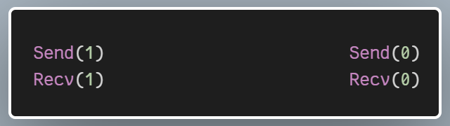
Send
MPI_Ssend runs the risk of deadlock.
MPI_Bsend less likely to deadlock, but (a) user must supply buffer, (b) routine may fail if buffer is exhausted.
MPI_Send tries to solve these problems
Buffer space provided by system
Send will normally be asynchronous (like Bsend)
If buffer is full, Send becomes synchronous (like Ssend)
Unlikely to fail (but could still deadlock)
UNSAFE
Process 0
Process 1

Slide 52
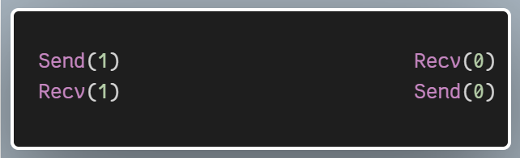
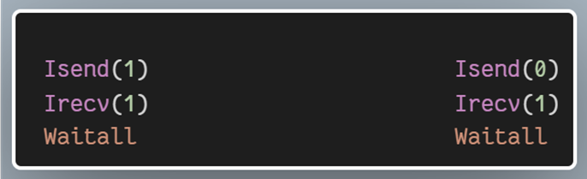
Possible Solutions
Pingpong communications
Match communications deliberately to avoid deadlock.
Process 0 sends, then receives Process 1 receives, then sends
Non-blocking communications (e.g., MPI_Isend, MPI_Irecv)
MPI_I<function>: Immediate version of function.
Return: Functions that return immediately, without waiting for the operation to complete.
Purpose: Allows a program to overlap communication with computation.
Completion: You must explicitly check or wait for completion using MPI_Wait, MPI_Test, etc.
Process 0
Process 1
Process 0
Process 1

Slide 53

Pt2PT Communication - Test Your Knowledge
X = 23
if(rank==0) MPI_Send(X,1)
if(rank==1)
MPI_Recv(Y,0)
int x;
int y;
int x;
int y;
myApp
myApp
0
Rank
Rank
>> x =
y =
>> x =
y =
23
23
?
?

Slide 54
Pt2PT Communication - Test Your Knowledge
X = 23
if(rank==0) MPI_Send(X,1)
if(rank==1)
MPI_Recv(Y,0)
Send
int x;
int y;
int x;
int y;
23
myApp
myApp
0
Rank
Rank
>> x =
y =
>> x =
y =
23
23
?
?

Slide 55
Pt2PT Communication - Test Your Knowledge
X = 23
if(rank==0) MPI_Send(X,1)
if(rank==1)
MPI_Recv(Y,0)
Send
int x;
int y;
int x;
int y;
23
myApp
myApp
0
Rank
Rank
Recv
>> x =
y =
>> x =
y =
23
23
?
23

Slide 56
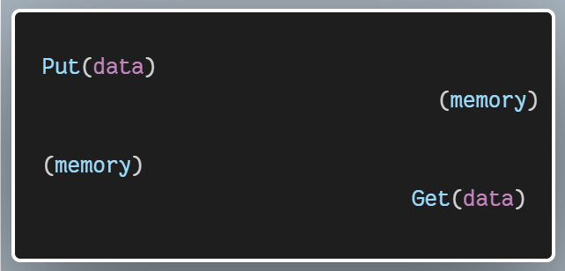
One-Sided Operations for Communication (RMA)
Process 0
Process 1
// Put data into a memory window on a remote process
int MPI_Put(…);
// Get data from a memory window on a remote process
int MPI_Get(…);

Slide 57

Collective Communications
Group communication between sets of processes
Can be done using simple (pt2pt) messages, but often implemented separately for efficiency
Called by all processes in a communicator.

Slide 58
Broadcast
8
8
8
8
8
8
8
8
From one process to all processes in comm

Slide 59
Scatter
0
0 1 2 3 6 7 9 4
1
4
2
9
3
7
6
Information scatter to all processes in comm

Slide 60
Gather
0
0 1 2 3 6 7 9 4
1
4
2
9
3
7
6
Information gathered to one process in comm

Slide 61
AllGather
0 1 2 3 6 7 9 4
0
0 1 2 3 6 7 9 4
1
4
0 1 2 3 6 7 9 4
0 1 2 3 6 7 9 4
0 1 2 3 6 7 9 4
9
2
0 1 2 3 6 7 9 4
3
7
0 1 2 3 6 7 9 4
0 1 2 3 6 7 9 4
6
Information gathered to all processes in comm

Slide 62
Reduce
MPI_SUM
0
32
1
4
2
9
3
7
6
MPI_MINLOC
MPI_MAXLOC
Form a global sum, product, max, min, etc. to one process in comm

Slide 63
Summary
Message-Passing is a programming model
Implemented by MPI
The Message-Passing Interface (MPI) is a library of functions
Essential to understand the basic concepts
Private variables
Explicit communications
SPMD
Difficulty comes from the Message-Passing model
Very different from sequential programming

Slide 64
Language Interfaces
Official MPI Bindings (defined in the MPI Standard)
C/C++, Fortran
Third-Party Bindings (Community Libraries)
Python, Julia, Java, Rust, Go, R, MATLAB
Python: I added some Python examples to this course
mpi4py package: wrappers for standard library
https://mpi4py.readthedocs.io/
Two versions of comms routines: upper and lower case
comm.Send() - for NumPy arrays
comm.send() - for arbitrary datatypes

Slide 65
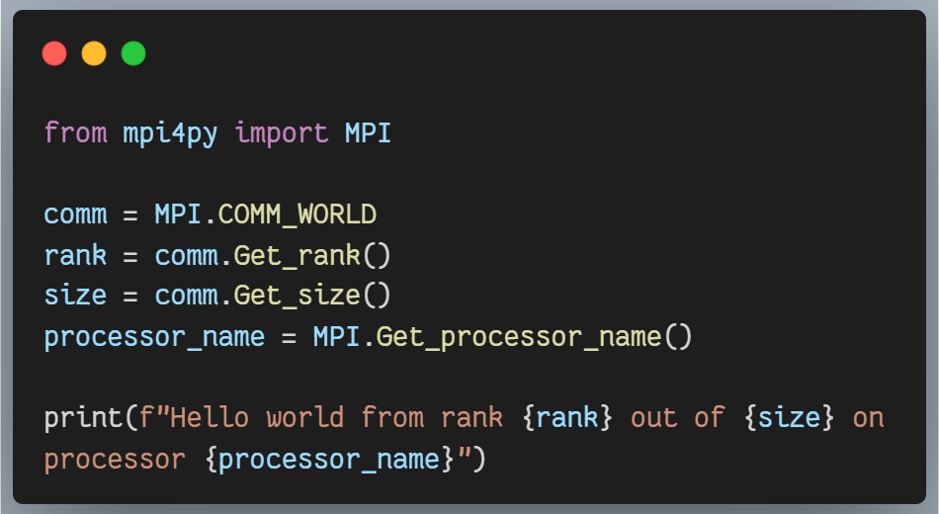
HPC Python Session (Wednesday – 9:00 AM)
Ramses van Zon

Slide 66
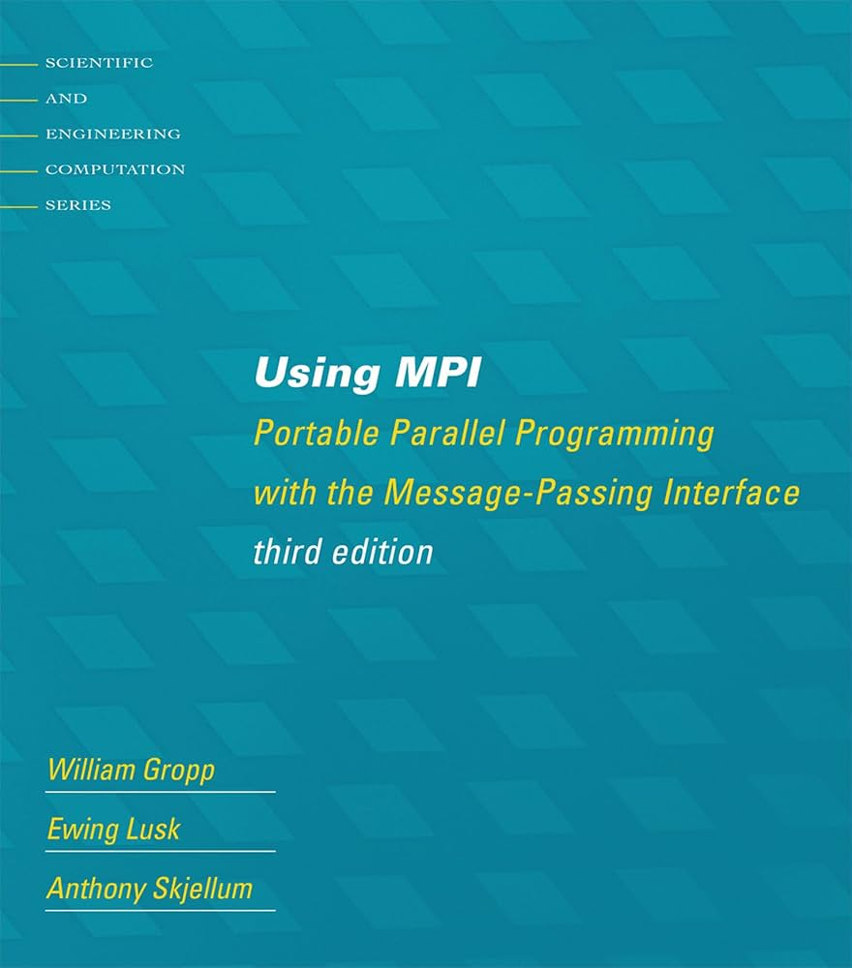
Documentation
MPI Standard available online
See: http://www.mpi-forum.org/docs/
Currently on version 5.0
Manual (man) pages on Bridges2
Must load MPI module
e.g., user@bridges2$ man MPI_Init
Excellent Resource
https://rookiehpc.org/
Textbook: Using MPI

Slide 67
Section II
Derived Data Types

Slide 68






MPI_Send/MPI_ReCv
int MPI_Send(const void *sbuf,
int count,
MPI_Datatype datatype,
int dest,
int tag,
MPI_Comm comm);
// [in] Initial address of send buffer
// [in] Maximum number of elements to send
// [in] Datatype of each send buffer entry
// [in] Rank of destination (integer)
// [in] Message tag (integer)
// [in] Communicator (handle)
Rank
int MPI_Recv(void *rbuf,
int count,
MPI_Datatype datatype,
int source,
int tag,
MPI_Comm comm,
MPI_Status *status);
// [out] Initial address of receive buffer
// [in] Maximum number of elements to recv
// [in] Datatype of each recv buffer entry
// [in] Rank of source (integer)
// [in] Message tag (integer)
// [in] Communicator (handle)
// [out] Status object (status)
Rank

Slide 69
MPI Intrinsic DATA TYPES
C/C++ |  | FORTRAN
MPI_CHAR MPI_WCHAR MPI_SHORT MPI_INT MPI_LONG MPI_LONG_LONG_INT MPI_LONG_LONG MPI_SIGNED_CHAR MPI_UNSIGNED_CHAR MPI_UNSIGNED_SHORT MPI_UNSIGNED_LONG MPI_UNSIGNED MPI_FLOAT MPI_DOUBLE MPI_LONG_DOUBLE | MPI_C_COMPLEX MPI_C_FLOAT_COMPLEX MPI_C_DOUBLE_COMPLEX MPI_C_LONG_DOUBLE_COMPLEX MPI_C_BOOL MPI_LOGICAL MPI_C_LONG_DOUBLE_COMPLEX MPI_INT8_T MPI_INT16_T MPI_INT32_T MPI_INT64_T MPI_UINT8_T MPI_UINT16_T MPI_UINT32_T MPI_UINT64_T MPI_BYTE MPI_PACKED | MPI_CHARACTER MPI_INTEGER MPI_INTEGER1 MPI_INTEGER2 MPI_INTEGER4 MPI_REAL MPI_REAL2 MPI_REAL4 MPI_REAL8 MPI_DOUBLE_PRECISION MPI_COMPLEX MPI_DOUBLE_COMPLEX MPI_LOGICAL MPI_BYTE MPI_PACKED
69

Slide 70
MPI DATA TYPES
Recall : MPI just gets the starting
address of the memory you want to send/receive.
i.e.,
MPI_Send (const void *sbuf, … ) MPI_Recv ( void *rbuf, … )
What happens if we want
to send custom data
without making a copy?
MPI_Recv(void *rbuf,
int count,
MPI_Datatype datatype,
int source,
int tag,
MPI_Comm comm,
MPI_Status *status);
MPI_Send(const void *sbuf,
int count,
MPI_Datatype datatype,
int dest,
int tag,
MPI_Comm comm);

Slide 71

MPI DATA TYPES
We can serialize custom data into a message stream
>> Declarative specification of data layout <<
Derived Data Types
Contiguous
Vector
Indexed
Struct
contig
contig
contig
vector
indexed
struct

Slide 72
MPI Derived DATA TYPES
MPI_Type_contiguous
MPI_Type_vector
MPI_Type_create_hvector
MPI_Type_indexed
MPI_Type_create_indexed_block
MPI_Type_create_subarray
MPI_Type_create_darray
MPI_Type_create_struct
> contiguous datatype (no gaps)
> regularly spaced datatype (gaps)
> like vector, but stride is specified in bytes
> variably-spaced datatype
> special case of indexed
> subarray within a
multidimensional array
> distribution of a ndim-array into
a grid of ndim-logical processes
> fully general datatype
Likely discussed in Parallel I/O Session (Wednesday)

Slide 73
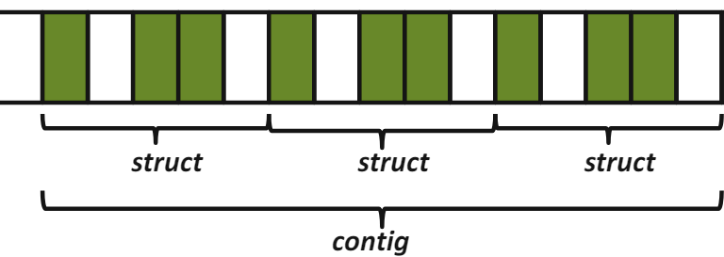
MPI_Type_contiguous
Creates a contiguous datatype.
int MPI_Type_contiguous(
int count,
MPI_Datatype oldtype,
MPI_Datatype *newtype);
// count: Number of entries.
// oldtype: Old datatype (handle).
// newtype: New datatype (handle).

Slide 74
MPI_Type_contiguous Example
float A[4][4]
Creates a contiguous datatype.
int MPI_Type_contiguous(
int count,
MPI_Datatype oldtype,
MPI_Datatype *newtype);
1.0 | 2.0 | 3.0 | 4.0
5.0 | 6.0 | 7.0 | 8.0
9.0 | 10.0 | 11.0 | 12.0
13.0 | 14.0 | 15.0 | 16.0
MPI_Datatype row_type;
int MPI_Type_contiguous(
4, // count
MPI_FLOAT, // old type
&row_type); // new type
MPI_Type_commit(&row_type);
MPI_Send(&A[2][0],
1, row_type,
dest, tag, comm);
74

Slide 75
MPI_Type_Commit / Free / Dup
Types must be committed before use!
Only the DDT’s that are used
MPI_Type_commit may perform extensive optimizations
Types should be deleted when finished
Free up MPI resources
Does not affect types constructed from it
Types may be duplicated
May be useful for holding state of type before modification
MPI_Datatype ParticleType;
// Build DDT ...
MPI_Type_commit(&ParticleType);
MPI_Type_free(&ParticleType);
MPI_Datatype ParticleTypeDuplicate;
MPI_Type_dup(ParticleType,
&ParticleTypeDuplicate);

Slide 76
Hands On Activity #1
1.0 | 2.0 | 3.0 | 4.0
5.0 | 6.0 | 7.0 | 8.0
9.0 | 10.0 | 11.0 | 12.0
13.0 | 14.0 | 15.0 | 16.0
MPI_Type_contiguous
MPI_Type_vector
MPI_Type_indexed
MPI_Type_create_struct

Slide 77
Exercise.1 Derived Data Types
ddt.1.contiguous
int MPI_Type_contiguous(
int count,
MPI_Datatype oldtype,
MPI_Datatype *newtype);
Rank 0 B[4] =
1.0 | 2.0 | 3.0 | 4.0
A[4][4]
Rank 1 B[4] =
5.0 | 6.0 | 7.0 | 8.0
1.0 | 2.0 | 3.0 | 4.0
5.0 | 6.0 | 7.0 | 8.0
9.0 | 10.0 | 11.0 | 12.0
13.0 | 14.0 | 15.0 | 16.0
1.0 | 2.0 | 3.0 | 4.0
5.0 | 6.0 | 7.0 | 8.0
9.0 | 10.0 | 11.0 | 12.0
13.0 | 14.0 | 15.0 | 16.0
Rank 2 B[4] =
9.0 | 10.0 | 11.0 | 12.0
Rank 3 B[4] =
13.0 | 14.0 | 15.0 | 16.0
77
Rank 0

Slide 78
MPI_Type_vector
Creates a vector (strided) datatype.
int MPI_Type_vector(
int count,
int blocklen,
int stride,
MPI_Datatype oldtype,
MPI_Datatype *newtype);
How can we send the subarray?

Slide 79
MPI_Type_vector
Creates a vector (strided) datatype.
int MPI_Type_vector(
int count,
int blocklen,
int stride,
MPI_Datatype oldtype,
MPI_Datatype *newtype);
How can we send the subarray?

Slide 80
MPI_Type_vector Example #1
Creates a vector (strided) datatype.
int MPI_Type_vector(
int count,
int blocklen,
int stride,
MPI_Datatype oldtype,
MPI_Datatype *newtype);
// count: Number of blocks.
> “How many chunks of data?”
// blocklens: Number of elements in each block.
> “How many things in a chunk?”
// stride: Number of elements between start of each block.
> “How many units (of things) between chunks?
// oldtype: Old datatype (handle).
// newtype: New datatype (handle).
blocklen = 3
count = 2
stride = 5

Slide 81
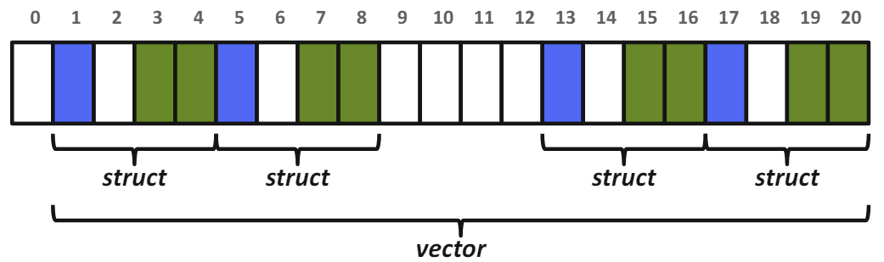
MPI_Type_vector Example #2
Creates a vector (strided) datatype.
int MPI_Type_vector(
int count,
int blocklen,
int stride,
MPI_Datatype oldtype,
MPI_Datatype *newtype);
// count: Number of blocks.
> “How many chunks of data?”
// blocklens: Number of elements in each block.
> “How many things in a chunk?”
// stride: Number of elements between start of each block.
> “How many units (of things) between chunks?
// oldtype: Old datatype (handle).
// newtype: New datatype (handle).

Slide 82
MPI_Type_vector Example #3
bx
int MPI_Type_vector(
int count,
int blocklen,
int stride,
MPI_Datatype oldtype,
MPI_Datatype *newtype);
MPI_Datatype HALO_Y_DIR_TYPE;
int MPI_Type_vector(
by, // count
1, // blocklen
bx+2, // stride
MPI_DOUBLE, // old type
&HALO_Y_DIR_TYPE);// new type
by

Slide 83
Hands On Activity #1
1.0 | 2.0 | 3.0 | 4.0
5.0 | 6.0 | 7.0 | 8.0
9.0 | 10.0 | 11.0 | 12.0
13.0 | 14.0 | 15.0 | 16.0
MPI_Type_contiguous
MPI_Type_vector
MPI_Type_indexed
MPI_Type_create_struct

Slide 84
Exercise.1 Derived Data Types
ddt.2.vector
int MPI_Type_vector(
int count,
int blocklen,
int stride,
MPI_Datatype oldtype,
MPI_Datatype *newtype);
Rank 0 B[4] =
1.0 | 5.0 | 9.0 | 13.0
A[4][4]
Rank 1 B[4] =
2.0 | 6.0 | 10.0 | 14.0
1.0 | 2.0 | 3.0 | 4.0
5.0 | 6.0 | 7.0 | 8.0
9.0 | 10.0 | 11.0 | 12.0
13.0 | 14.0 | 15.0 | 16.0
1.0 | 2.0 | 3.0 | 4.0
5.0 | 6.0 | 7.0 | 8.0
9.0 | 10.0 | 11.0 | 12.0
13.0 | 14.0 | 15.0 | 16.0
1.0 | 2.0 | 3.0 | 4.0
5.0 | 6.0 | 7.0 | 8.0
9.0 | 10.0 | 11.0 | 12.0
13.0 | 14.0 | 15.0 | 16.0
1.0 | 2.0 | 3.0 | 4.0
5.0 | 6.0 | 7.0 | 8.0
9.0 | 10.0 | 11.0 | 12.0
13.0 | 14.0 | 15.0 | 16.0
Rank 2 B[4] =
3.0 | 7.0 | 11.0 | 15.0
Rank 3 B[4] =
4.0 | 8.0 | 12.0 | 16.0
84
Rank 0

Slide 85
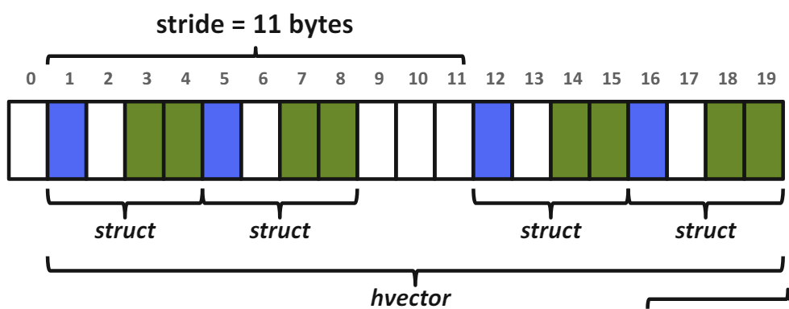
MPI_Type_create_hvector (MPI_Type_hvector deprecated)
Creates a vector (strided) data type with offset in bytes.
int MPI_Type_create_hvector(
int count,
int blocklen,
MPI_Aint stride,
MPI_Datatype oldtype,
MPI_Datatype *newtype);
// count : Number of blocks.
// blocklens : Number of elements in each block. // stride : Number of bytes between start of each block.
// oldtype : Old datatype (handle).
// newtype : New datatype (handle).

Slide 86
MPI_Type_create_hvector Example
bx
int MPI_Type_create_hvector(
int count,
int blocklen,
MPI_Aint stride,
MPI_Datatype oldtype,
MPI_Datatype *newtype);
MPI_Datatype HALO_Y_DIR_HTYPE;
int MPI_Type_create_hvector(
by, // count
1, // blocklen
(bx+2)*sizeof(double), // byte stride
MPI_DOUBLE, // old type
&HALO_Y_DIR_HTYPE);// new type
by

Slide 87
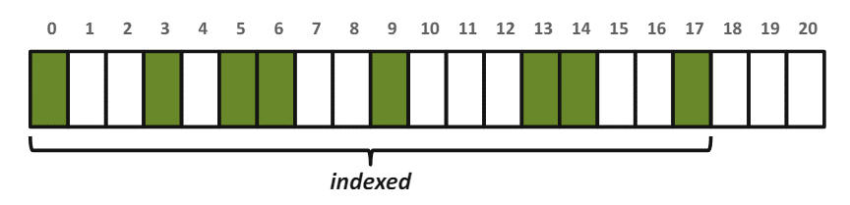
MPI_Type_indexed
Creates an indexed datatype.
int MPI_Type_indexed(
int count,
int *array_of_blocklens,
int *array_of_displacements,
MPI_Datatype oldtype,
MPI_Datatype *newtype);
// count: Number of data blocks.
// array_of_blocklens: Size of each block (ints).
// array_of_displacements: Array of displacements (ints).
In units of extent of oldtype.
// oldtype: Old datatype (handle).
// newtype: New datatype (handle).

Slide 88
MPI_Type_indexed Example
int blocklens[6] = {1,1,2,1,2,1};
int displace[6] = {0,3,5,9,13,17};
int MPI_Type_indexed(6,
blocklens,
displace,
MPI_DOUBLE,
&new_index_type);
// count: Number of data blocks.
// array_of_blocklens: Size of each block (ints).
// array_of_displacements: Array of displacements (ints).
In units of extent of oldtype.
// oldtype: Old datatype (handle).
// newtype: New datatype (handle).

Slide 89
Hands On Activity #1
1.0 | 2.0 | 3.0 | 4.0
5.0 | 6.0 | 7.0 | 8.0
9.0 | 10.0 | 11.0 | 12.0
13.0 | 14.0 | 15.0 | 16.0
MPI_Type_contiguous
MPI_Type_vector
MPI_Type_indexed
MPI_Type_create_struct

Slide 90
Exercise.1 Derived Data Types
ddt.3.indexed
int MPI_Type_indexed(
int count,
int *array_of_blocklens,
int *array_of_displacements,
MPI_Datatype oldtype,
MPI_Datatype *newtype);
Rank 0
A[16]
1 | 2 | 3 | 4 | 5 | 6 | 7 | 8 | 9 | 10 | 11 | 12 | 13 | 14 | 15 | 16
Block Count
Block Lengths
Displacements
Rank 0 B[6] =
6 | 7 | 8 | 9
13 | 14
Rank 2 B[6] =
6 | 7 | 8 | 9
13 | 14
Rank 1 B[6] =
6 | 7 | 8 | 9
13 | 14
Rank 3 B[6] =
6 | 7 | 8 | 9
13 | 14
90

Slide 91
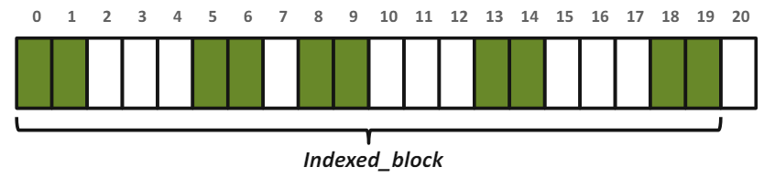
MPI_Type_create_Indexed_block
Creates an indexed data type with the same block length for all blocks.
int MPI_Type_create_indexed_block(
int count,
int blocklen,
int *array_of_displacements,
MPI_Datatype oldtype,
MPI_Datatype *newtype);
// count: Length of array of displacements.
// blocklen: Size of block (int).
// array_of_displacements: Array of displacements (ints).
In units of extent of oldtype.
// oldtype: Old datatype (handle).
// newtype: New datatype (handle).

Slide 92
MPI_Type_create_Indexed_block Example
int displacement[5] = {0,5,8,13,18};
int MPI_Type_create_indexed_block(
5,
2,
displacement,
MPI_DOUBLE,
&new_indexed_block_type);
// count: Length of array of displacements.
// blocklen: Size of block (int).
// array_of_displacements: Array of displacements (ints).
In units of extent of oldtype.
// oldtype: Old datatype (handle).
// newtype: New datatype (handle).

Slide 93
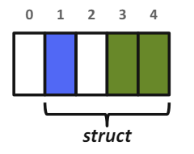
MPI_Type_create_struct
Creates a structured data type.
int MPI_Type_create_struct(
int count,
int *array_of_blocklens,
MPI_Aint *array_of_displacements,
MPI_Datatype *array_of_types,
MPI_Datatype *newtype);
// count: Number of blocks (type entries).
// array_of_blocklens: Array of block lengths.
// array_of_displacements:
Array of byte displacements.
// array_of_types: Array of old datatypes.
// newtype: New datatype (handle).
typedef struct {
int id;
char flag;
float x, y;
} data_struct;

Slide 94
MPI_Type_extent
For creating struct datatypes, we need
need byte displacements/offsets
MPI_Type_extent (not safe!)
struct {
float x, y, z, velocity;
int n, type;
} Particle;
Particle particles[NELEM];
MPI_Type_extent(MPI_FLOAT, &extent);
count = 2;
blockcounts[0] = 4; blockcount[1] = 2;
oldtypes[0] = MPI_FLOAT; oldtypes[1] = MPI_INT;
displ[0] = 0; displ[1] = 4*extent;
int MPI_Type_create_struct(
int count,
int *array_of_blocklens,
MPI_Aint *array_of_displacements,
MPI_Datatype *array_of_types,
MPI_Datatype *newtype);
… … …
f | f | f | f | i | i
f | f | f | f | i | i
particles[NELEM];

Slide 95
Mind the alignments!
C struct may be automatically padded by the compiler!
struct {
char a;
char gap0[3];
int b;
char c;
char gap1[3];
} x;
struct {
char a;
int b;
char c;
} x;

Slide 96
MPI_Get_address
Good for handling inner padding issue…
But does not account for trailing struct padding
Important when sending more than one struct
struct {
float x, y, z, velocity;
int n, type;
} Particle;
Particle particles[NELEM];
MPI_Get_address(&Particle, &base);
MPI_Get_address(&Particle.x, &F_offset);
MPI_Get_address(&Particle.n, &I_offset);
count = 2;
blockcounts[0] = 4; blockcount[1] = 2;
oldtypes[0] = MPI_FLOAT; oldtypes[1] = MPI_INT;
displ[0] = F_offset - base; displ[1] = I_offset - base;
int MPI_Type_create_struct(
int count,
int *array_of_blocklens,
MPI_Aint *array_of_displacements,
MPI_Datatype *array_of_types,
MPI_Datatype *newtype);
… … …
f | f | f | f | i | i
f | f | f | f | i | i
particles[NELEM];

Slide 97
MPI_TYPE_CREATE_RESIZED
Returns a new data type with new extent and upper and lower bounds.
int MPI_Type_create_resized(
MPI_Datatype oldtype,
MPI_Aint lwrbnd,
MPI_Aint extent,
MPI_Datatype *newtype);
// oldtype: Input data type (handle).
// lwrbnd: New lower bound of data type (# of bytes).
// extent: New extent of data type (# of bytes).
// newtype: New datatype (handle).
Returns new datatype that is identical to oldtype,
except the lower bound of this new datatype is set to be “lb”,
and its upper bound is set to be “lb + extent”.

Slide 98
MPI_TYPE_CREATE_RESIZED Example
/* Sending an array of structs portably */
struct PartStruct particle[100];
MPI_Datatype ParticleType;
/* check if extent is correct */
MPI_Type_get_extent(ParticleType, &lb, &extent);
if (extent != sizeof(particle[0])) {
MPI_Datatype old = ParticleType;
MPI_Type_create_resized(old, // [in] old datatype
0, // [in] new lower bound byte offset
sizeof(particle[0]), // [in] new byte extent of data type
&ParticleType); // [out] new datatype
MPI_Type_free(&old);
}
MPI_Type_commit(&ParticleType);

Slide 99
MPI_Type_create_struct, Revisited Example
data_struct Data;
MPI_Aint base, member_offset;
MPI_Aint offsets[3];
int blockcounts[3];
MPI_Datatype oldtypes[3];
// compute base address in struct
MPI_Get_address(&Data, &base);
// description of the 1 MPI_INT field: id
MPI_Get_address(&Data.id, &member_offset);
offsets[0] = member_offset - base;
blockcounts[0] = 1;
oldtypes[0] = MPI_INT;
// description of the 1 MPI_CHAR field: flag
MPI_Get_address(&Data.flag, &member_offset);
offsets[1] = member_offset - base;
blockcounts[1] = 1;
oldtypes[1] = MPI_CHAR;
// description of the 2 MPI_FLOAT fields: x,y
MPI_Get_address(&Data.x, &member_offset);
offsets[2] = member_offset - base;
blockcounts[2] = 2;
oldtypes[2] = MPI_FLOAT;
MPI_Datatype new_struct_type;
int MPI_Type_create_struct(
3, // # of blocks
blockcounts, // # of elements in each block
offsets, // Byte displacements of each block
oldtypes, // Type of elements in each block
&new_struct_type); // New data type
// check if extent is correct of new_struct_type
MPI_Type_get_extent(new_struct_type, &lb, &extent);
...
typedef struct {
int id;
char flag;
float x, y;
} data_struct;

Slide 100
Hands On Activity #1
1.0 | 2.0 | 3.0 | 4.0
5.0 | 6.0 | 7.0 | 8.0
9.0 | 10.0 | 11.0 | 12.0
13.0 | 14.0 | 15.0 | 16.0
MPI_Type_contiguous
MPI_Type_vector
MPI_Type_indexed
MPI_Type_create_struct

Slide 101
Exercise.1 Derived Data Types
ddt.4.struct
int MPI_Type_create_struct(
int count,
int *array_of_blocklens,
MPI_Aint *array_of_displacements,
MPI_Datatype *array_of_types,
MPI_Datatype *newtype);
typedef struct {
float x, y, z, velocity;
int n, type;
} Particle;
Particle particles[NELEM];
f | f | f | f | i | i
… … … … … …
f | f | f | f | i | i
particles[NELEM];

Slide 102
MPI_Op_Create
Creates a user-defined combination function handle.
int MPI_Op_create(
MPI_User_function *function,
int commute,
MPI_Op *op);
// function: User-defined function.
// commute: True if commutative; false otherwise.
// op : Custom operation (handle).
MPI_Op op;
MPI_Datatype ctype;
mpiret = MPI_Type_contiguous(7, MPI_DOUBLE, &ctype); mpiret = MPI_Type_commit(&ctype);
mpiret = MPI_Op_create((MPI_User_function *) stats_mpifunc, 1, &op);
mpiret = MPI_Allreduce(flatin, flatout, nvars, ctype, op, mpicomm);

Slide 103
MPI_Op_Create
Creates a user-defined combination function handle.
int MPI_Op_create(
MPI_User_function *function,
int commute,
MPI_Op *op);
// function: User-defined function.
// commute: True if commutative; false otherwise.
// op : Custom operation (handle).
mpiret = MPI_Op_create((MPI_User_function *) stats_mpifunc, 1, &op);
mpiret = MPI_Allreduce(flatin, flatout, nvars, ctype, op, mpicomm);
typedef void MPI_User_function(void *invec,
void *inoutvec,
int *len,
MPI_Datatype *datatype);

Slide 104
MPI_Op_Create Example
// Define Custom Collective Function
void accumulate_values_func(void *invec,
void *inoutvec, int *len,
MPI_Datatype *datatype){
const int IX=0, IY=1, IZ=2, NINDEX=3;
double *in = (double *) invec;
double *inout = (double *) inoutvec;
/* sum values */ for (int i = 0; i < *len; ++i) {
inout[IX] += in[IX];
inout[IY] += in[IY];
inout[IZ] += in[IZ];
/* advance to next data set */
in += NINDEX;
inout += NINDEX;
}
}
// Construct MPI Type & Op
MPI_Op op;
MPI_Datatype ctype;
double values[3*npoints]; // TODO: init
double value_sums[3*npoints]; // TODO: zero
/* create contiguous type & commit */
MPI_Type_contiguous(3, // stack 3 doubles
MPI_DOUBLE, &ctype);
MPI_Type_commit(&ctype);
/* create MPI Op & perform Allreduce */ MPI_Op_create( (MPI_User_function *) accumulate_values_func, 1, // commutative operation &op); // [out] MPI Op (handle)
MPI_Allreduce(values, value_sums, npoints, ctype, op, comm);

Slide 105
DDT Review: Selection order
Simple and effective performance model
More parameters == slower performance
predefined < contig < vector < indexed_block < index < struct
Advice to developers
Construct datatypes hierarchically bottom-up

Slide 106
Section III
Virtual Topologies

Slide 107
Structured Meshes
Typical Communication Pattern
4 Neighbors
A structured mesh is a mesh where one can find a connectivity pattern that applies to every element in the mesh.

Slide 108
Structured Meshes
Typical Communication Pattern
6 Neighbors
A structured mesh is a mesh where one can find a connectivity pattern that applies to every element in the mesh.

Slide 109





Structured Meshes
Hexahedrons
Tetrahedrons
Pyramids
Dodecahedrons

Slide 110
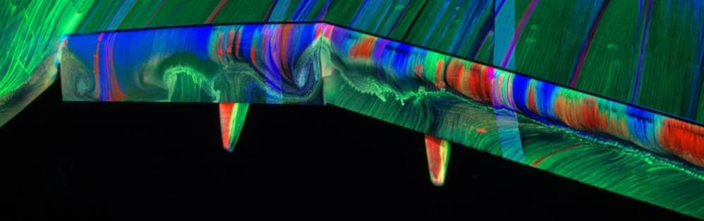
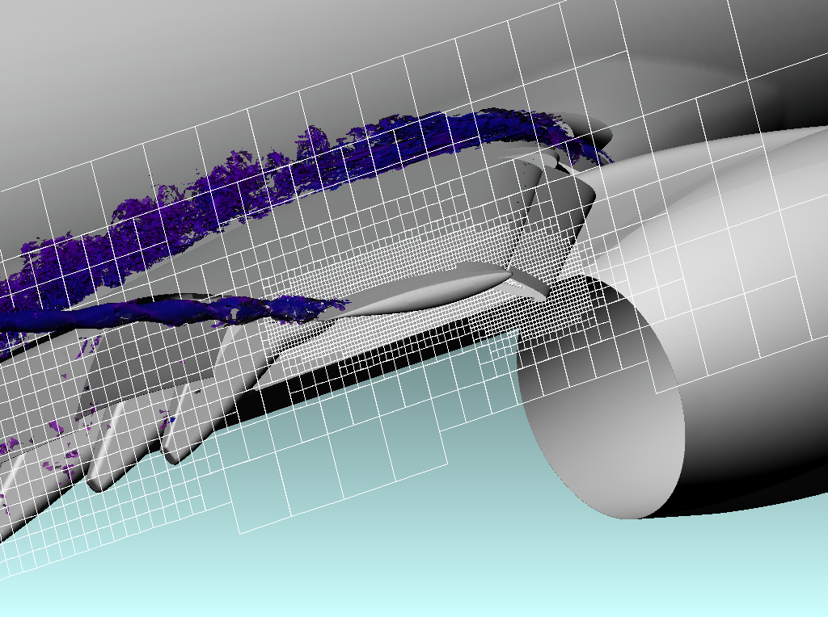

Example: Computational Fluid Dynamics

Slide 111
Load Balancing
Basic Partitioning
Load balancing a structured mesh typically comes down to partitioning the mesh to have an equal number of elements per Processing Element (PE).
Partition 0
Partition 1
Partition 2
Partition 3

Slide 112
Load Balancing
Basic Partitioning
Load balancing a structured mesh typically comes down to partitioning the mesh to have an equal number of elements per Processing Element (PE).
Partition 0
Partition 1
Partition 2

Slide 113
Load Balancing: A little less Trivial
Basic Partitioning
Pros
No need to alter the underlying decomposition.
Cons
Load-imbalance present: 3 MPI processes have 9 elements, whereas 1 MPI process has 5 elements.
Partition 0
Partition 1
Partition 2
Partition 3

Slide 114
Load Balancing: A little less Trivial
Cyclic Partitioning
Pros
Every MPI process is assigned 8 elements.
Cons
Hindered data locality as elements are rarely consecutive.
Partition 0
Partition 1
Partition 2
Partition 3

Slide 115
Load Balancing: A little less Trivial
Advanced Partitioning
Pros
Every PE has an identical number of elements (8).
Most elements are consecutive
Cons
More complex.
Takes more time to complete.
Partition 0
Partition 1
Partition 2
Partition 3

Slide 116
Partitioning YOUR PROBLEM:
Hard.
In general, user is responsible for partitioning!

Slide 117
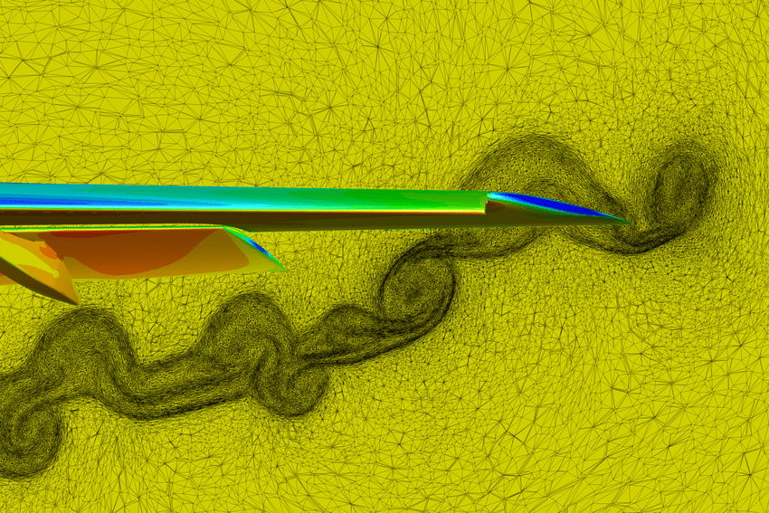
Unstructured Meshes
Partitioning octree unstructured meshes?
Partitioning adaptive meshes?
Partitioning fully unstructured meshes?
Source: NASA FUN3D

Slide 118
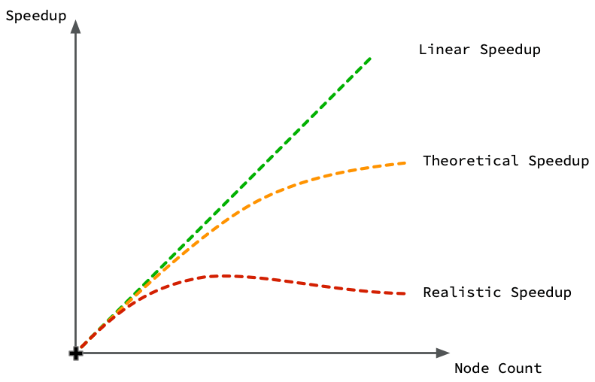
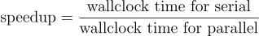
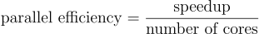
Why is it Important? Parallel Performance

Slide 119
ViRtual Topology: What? Why?
What is it?
A virtual topology is the arrangement of MPI processes.
Why is it useful?
Provide convenient and intuitive constructions, e.g., finding ranks with shifts in a Cartesian virtual topology.
Inform the MPI runtime of the communications patterns – improve the placement of MPI processes to hardware.
VirTops are not required (c.f.: do communications yourself), but
Simplifies writing of code.
Better Performance
119

Slide 120
ViRtual Topology: Factors to consider
MPI process contains one thread, which is eventually run by a hardware thread.
Certain hardware threads may be on the same core.
Certain caches may be shared by multiple cores (typically, L3).
Certain cores may belong to the same processor and thus access the same memory module(s) (c.f.: NUMA region).
Certain processors may be on different nodes.
Certain nodes may be on different racks.
Back to “Why is it useful?”
By declaring a virtual topology, the MPI runtime environment has extra information to leverage for a more efficient placement.
Better Performance
120

Slide 121
Virtual Topology: Cartesian
Goal: Make a new communicator with Cartesian topology information attached.
0
[0][0]
1
[0][1]
2
[0][2]
3
[0][3]
4
[1][0]
5
[1][1]
6
[1][2]
7
[1][3]
8
[2][0]
9
[2][1]
10
[2][2]
11
[2][3]
121

Slide 122
MPI_Cart_create
Makes a new communicator to which Cartesian topology information has been attached.
int MPI_Cart_create(
MPI_Comm comm_old,
int ndims,
const int dims[],
const int periods[], int reorder,
MPI_Comm *comm_cart);
// comm_old: Input communicator.
// ndims: Number of dimensions of Cartesian grid (>= 0).
// dims: Array of size ndims specifying number of processes in each dimension.
// periods: Array of size ndims specifying whether dim is periodic.
// reorder: Rank reordering flag.
// comm_cart: Output communicator with Cart topology.
122

Slide 123
MPI_Dims_create
Partitions Cartesian meshes.
Creates a division of processors in a Cartesian grid.
int MPI_Dims_create(
int nnodes,
int ndims,
int dims[]);
// nnodes: Number of nodes in grid.
// ndims: Number of Cartesian Topology dimensions.
// dims: Array of size ndims specifying number of nodes in each dimension.
Nonzero values in dims sets the number of processes required in that direction.
WARNING: make sure dims is set to 0 before the call
dims before call | Function call | dims on return
(0, 0) | MPI_Dims_create (6, 2, dims); | (3, 2)
(0, 0) | MPI_Dims_create (7, 2, dims); | (7, 1)
(0, 3, 0) | MPI_Dims_create (6, 3, dims); | (2, 3, 1)
(0, 3, 0) | MPI_Dims_create (7, 3, dims); | Erroneous call
123

Slide 124
Virtual Topology: Cartesian Mapping Functions
MPI_Cart_rank - Determines process rank in communicator given Cartesian location.
int MPI_Cart_rank(
MPI_Comm comm_cart,
int coords[],
int *rank);
0
[0][0]
1
[0][1]
2
[0][2]
3
[0][3]
4
[1][0]
5
[1][1]
6
[1][2]
7
[1][3]
int coords[2] = {1,2};
MPI_Cart_rank(comm_cart,
coords,
&rank);
>> rank = 6
8
[2][0]
9
[2][1]
10
[2][2]
11
[2][3]
124

Slide 125
Virtual Topology: Cartesian Mapping Functions
MPI_Cart_coords - Determines process coords in Cartesian topology given rank in group.
int MPI_Cart_coords(
MPI_Comm comm_cart,
int rank,
int maxdims,
int coords[]);
0
[0][0]
1
[0][1]
2
[0][2]
3
[0][3]
4
[1][0]
5
[1][1]
6
[1][2]
7
[1][3]
int rank = 6, maxdims = 2;
MPI_Cart_coords(comm_cart,
rank, maxdims,
coords);
>> coords[] = {1,2}
8
[2][0]
9
[2][1]
10
[2][2]
11
[2][3]
125

Slide 126
Virtual Topology: Cartesian Mapping Functions
MPI_Cart_shift - Returns the shifted source and destination ranks, given a shift direction and amount.
int MPI_Cart_shift(
MPI_Comm comm_cart,
int direction,
int displacement,
int *rank_source, int *rank_dest);
0
[0][0]
1
[0][1]
2
[0][2]
3
[0][3]
4
[1][0]
5
[1][1]
6
[1][2]
7
[1][3]
[in] direction : Coordinate index of shift
[in] displacement : > 0: positive shift, < 0: negative shift
8
[2][0]
9
[2][1]
10
[2][2]
11
[2][3]
126

Slide 127

Virtual Topology: Cartesian Mapping Functions
MPI_Cart_shift - Returns the shifted source and destination ranks, given a shift direction and amount.
LEXICOGRAPHIC ORDERING
0
[0][0]
1
[0][1]
2
[0][2]
3
[0][3]
+X
4
[1][0]
5
[1][1]
6
[1][2]
7
[1][3]
+Y
[in] direction : Coordinate index of shift
[in] displacement : > 0: positive shift, < 0: negative shift
8
[2][0]
9
[2][1]
10
[2][2]
11
[2][3]
+Z
127

Slide 128
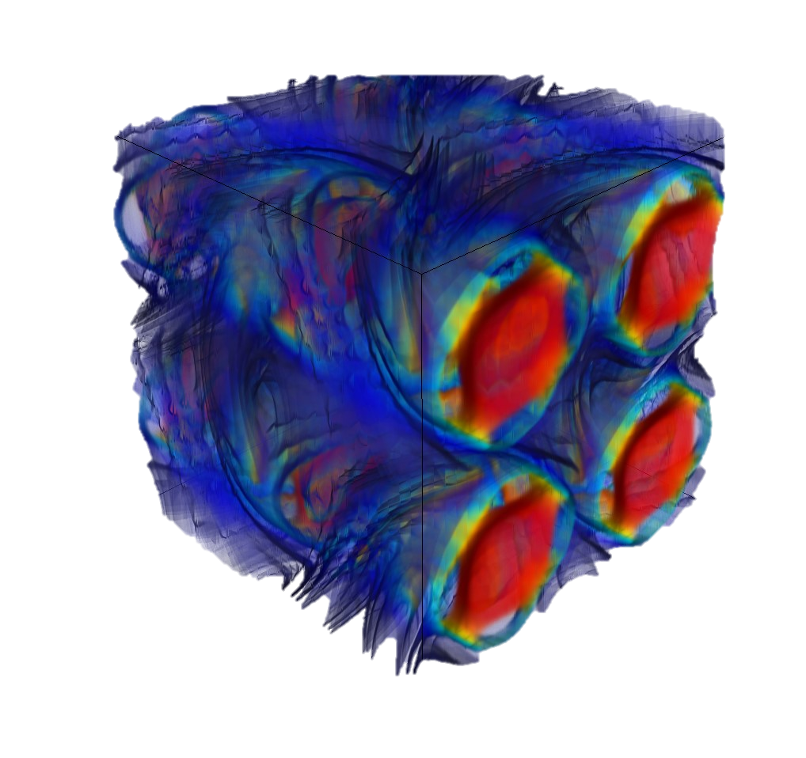
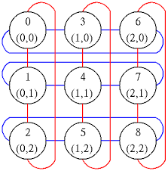
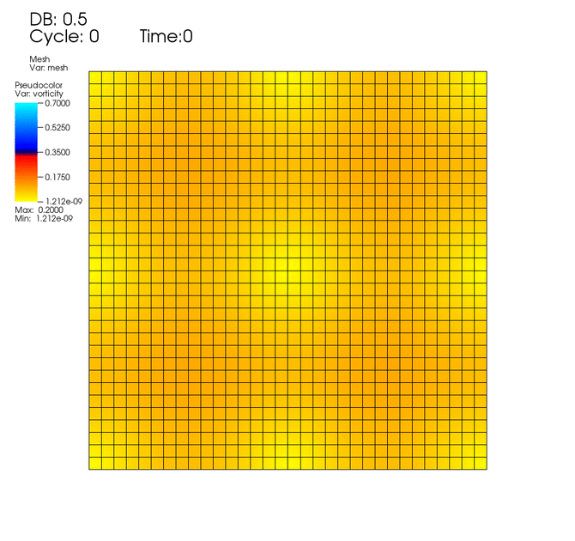
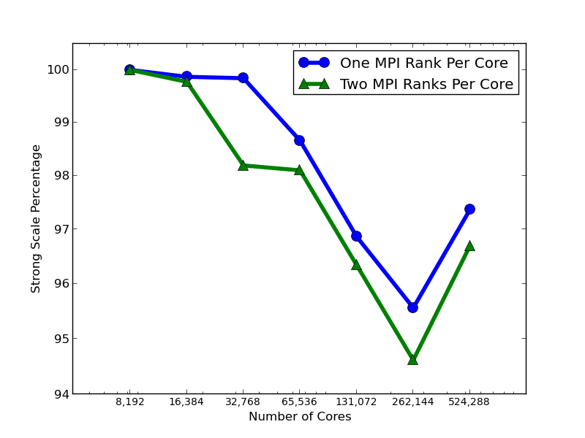
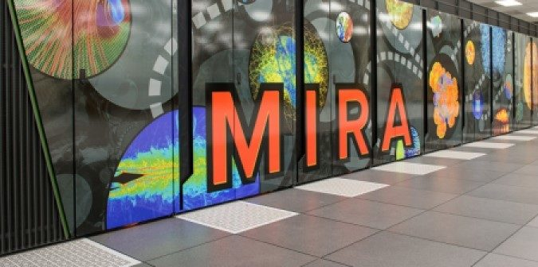
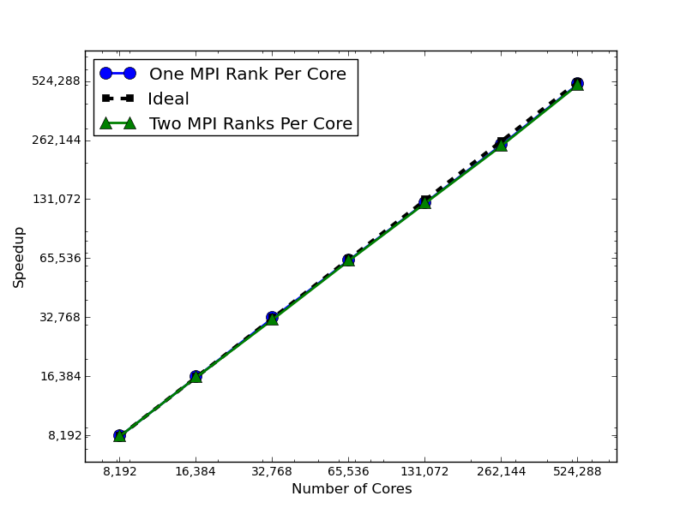
MPI_Cart_shift: Parallel Scaling
Strong Scaling on ALCF Mira
Taylor-Green Vortex
Fully periodic
Periodic Mesh: [512, 512, 512]
Discontinuous Galerkin: 5th -order
16.8 Billion DOFs
83.9 Billion unknowns
1 Million MPI Ranks

Slide 129
Virtual Topology: Graphs (FYI)
Can make a new communicator with Graph Topology information attached!
0
1
1983
190
1160
2917
2215
3
5
2
4
840
2970
3667
6
7
129

Slide 130

Hands On Activity #2
MPI_Cart_shift

Slide 131

Exercise.2 Cartesian Virtual Topologies
Step 1: cd exercises/Exercise.2-CartesianTopology/{c or f90}
Step 2: Complete the “TODO” tasks in stencil_cart_shift.{c or f90}
$$−Δu\left(x,y\right)=f$$
[0][0]
[0][1]
[0][2]
rx
[1][0]
[1][1]
[1][2]
ry
[2][0]
[2][1]
[2][2]
4 Neighbors
Typical Communication Pattern
131

Slide 132
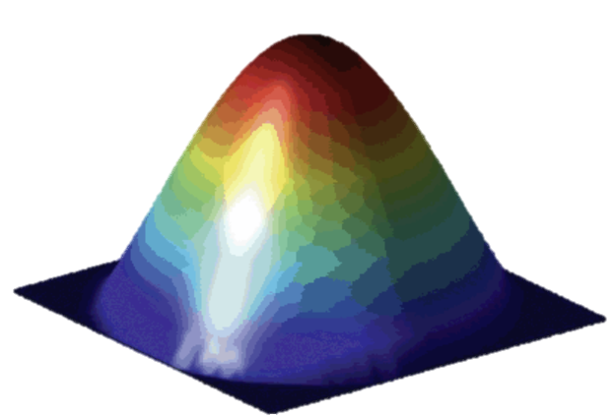

Exercise.2 Cartesian Virtual Topologies
Step 1: cd exercises/Exercise.2-CartesianTopology/{c or f90}
Step 2: Complete the “TODO” tasks in stencil_cart_shift.{c or f90}
$$−Δu\left(x,y\right)=f$$
bx
by
132

Slide 133
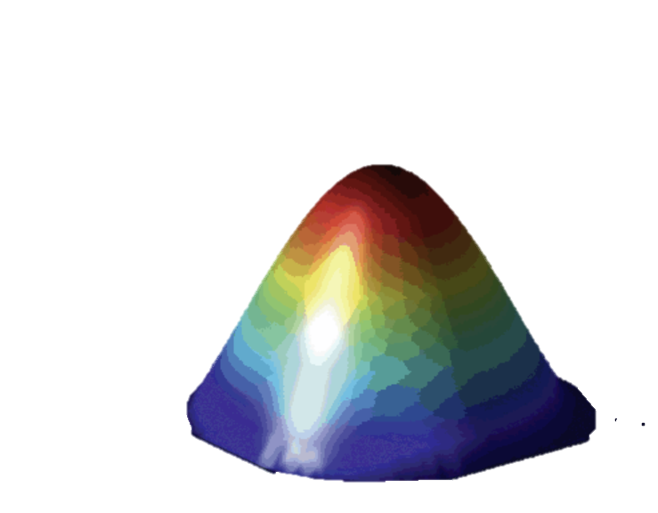
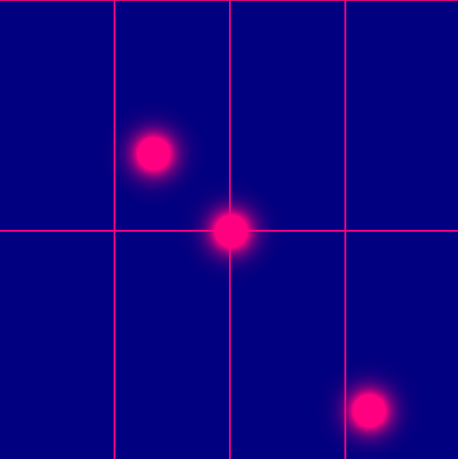
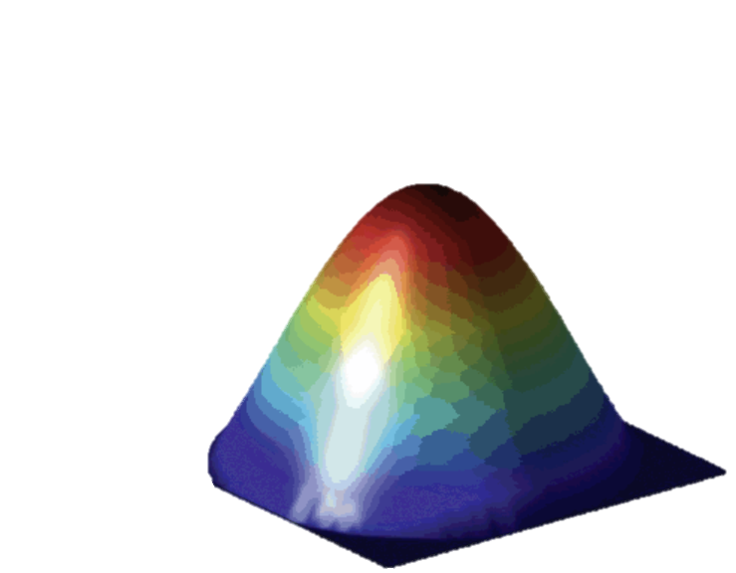


Exercise.2 Cartesian Virtual Topologies
Step 1: cd exercises/Exercise.2-CartesianTopology/{c or f90}
Step 2: Complete the “TODO” tasks in stencil_cart_shift.{c or f90}
5
10
Time
15
20
SOLUTIONS: cd exercises/Exercise.2-CartesianTopology/.soln
$$−Δu\left(x,y\right)=f$$
133

Slide 134
Section IV
Neighborhood Collectives

Slide 135
Neighborhood Collectives
Virtual Topologies implement no communication!
They are just helper functions.
Collective Communications only cover some patterns
E.g., no stencil patterns.
Neighborhood collectives add communication functions to process topologies.

Slide 136
MPI_[I]Neighbor_allgather[V/W]
Gathers and distributes data from and to all neighbors.
int MPI_Neighbor_allgather(
const void *sendbuf,
int sendcount,
MPI_Datatype sendtype,
void *recvbuf,
int recvcount,
MPI_Datatype recvtype,
MPI_Comm comm);
// sendbuf: Starting address of send buffer.
// sendcount: Number of elements in send buffer (integer).
// sendtype: Datatype of send buffer elements (handle).
// recvbuf: Starting address of recv buffer.
// recvcount: Number of elements in send buffer (integer).
// recvtype: Datatype of send buffer elements (handle).

Slide 137
MPI_[I]Neighbor_allgather[V/W]
Gathers and distributes data from and to all neighbors.
int MPI_Neighbor_allgather(
const void *sendbuf,
int sendcount,
MPI_Datatype sendtype,
void *recvbuf,
int recvcount,
MPI_Datatype recvtype,
MPI_Comm comm);

Slide 138
MPI_[I]Neighbor_alltoall[V/W]
All processes send data to neighboring processes in a virtual topology communicator.
int MPI_Neighbor_alltoall(
const void *sendbuf,
int sendcount,
MPI_Datatype sendtype,
void *recvbuf,
int recvcount,
MPI_Datatype recvtype,
MPI_Comm comm);
// sendbuf: Starting address of send buffer.
// sendcount: Number of elements in send buffer (integer).
// sendtype: Datatype of send buffer elements (handle).
// recvbuf: Starting address of recv buffer.
// recvcount: Number of elements in send buffer (integer).
// recvtype: Datatype of send buffer elements (handle).

Slide 139
MPI_[I]Neighbor_alltoall[V/W]
All processes send data to neighboring processes in a virtual topology communicator.
int MPI_Neighbor_alltoall(
const void *sendbuf,
int sendcount,
MPI_Datatype sendtype,
void *recvbuf,
int recvcount,
MPI_Datatype recvtype,
MPI_Comm comm);

Slide 140
Neighborhood Collectives: Cartesian
Communicate with direct neighbors in Cartesian topology
Corresponds to cart_shift with disp = 1
Collective:
all processes in comm must call it, including processes without neighbors
Buffers are laid out as neighbor sequence:
Defined by order of dimensions, first negative, then positive
2*ndims sources and destinations
Processes at borders (MPI_PROC_NULL) leave holes in buffers (will not be updated or communicated)!

Slide 141
Neighborhood Collectives: Cartesian
Communicate with direct neighbors in Cartesian topology
Buffer order example:
6
0
1
2
0
sendbuf
3
4
5
2
1
recvbuf
6
7
8
3

Slide 142

Hands On Activity #3
$$−Δu\left(x,y\right)=f$$
MPI_Ineighbor_alltoallv

Slide 143

Exercise.3 Neighborhood Collectives
Step 1: cd exercises/Exercise.3-NeighborhoodCollectives/{c}
Step 2: Complete the “TODO” tasks in stencil_mpi_carttopo_neighcolls.{c}
$$−Δu\left(x,y\right)=f$$
4 Neighbors
Typical Communication Pattern
143

Slide 144
MPI_Ineighbor_allgatherv
// sbuf: Starting address of send buffer.
// scounts: Number of elements to send to each neighbor.
// sdispls: Entry j specifies the displacement (relative to sendbuf) from which to send the outgoing data to neighbor j.
// stype: Datatype of send buffer elements.
// rbuf: Starting address of recv buffer.
// rcounts: Number of elements to be received from each neighbor.
// rdispls: Entry i specifies the displacement (relative to rbuf) at which to place the incoming data from neighbor i.
// rtype: Datatype of recv buffer elements.
int MPI_Ineighbor_allgatherv(
const void *sbuf,
const int scounts[],
const int sdispls[] ,
MPI_Datatype stype,
void *rbuf,
const int rcounts[],
const int rdispls[],
MPI_Datatype rtype,
MPI_Comm comm);

Slide 145
Exercise.3 MPI_Ineighbor_allgatherv
MPI_Ineighbor_alltoallv
Step 1: cd exercises/Exercise.3-NeighborhoodCollectives/{c or f90}
Step 2: Complete the “TODO” tasks in stencil_mpi_carttopo_neighcolls.{c or f90}
bx
Pack Send Buffer (green cells)
West, East, North, South
Recall Neighbor Ordering (X-, X+, Y-, Y+)
North
Counts[4] = {?, ?, ?, ?}
West
East
by
Displacements[4] = {?, ?, ?, ?}
South
sbuf
0 | 1 | 2 | 3 | 4 | 5 | 6 | 7 | 8 | 9 | 10 | 11 | 12 | 13 | 14 | 15 | 16 | 17 | 18 | 19 | 20 | 21 | 22 | 23 | 24 | 25 | 26 | 27
0 | 1 | 2 | 3 | 4 | 5 | 6 | 7 | 8 | 9 | 10 | 11 | 12 | 13 | 14 | 15 | 16 | 17 | 18 | 19 | 20 | 21 | 22 | 23 | 24 | 25 | 26 | 27
0 | 1 | 2 | 3 | 4 | 5 | 6 | 7 | 8 | 9 | 10 | 11 | 12 | 13 | 14 | 15 | 16 | 17 | 18 | 19 | 20 | 21 | 22 | 23 | 24 | 25 | 26 | 27
0 | 1 | 2 | 3 | 4 | 5 | 6 | 7 | 8 | 9 | 10 | 11 | 12 | 13 | 14 | 15 | 16 | 17 | 18 | 19 | 20 | 21 | 22 | 23 | 24 | 25 | 26 | 27
0 | 1 | 2 | 3 | 4 | 5 | 6 | 7 | 8 | 9 | 10 | 11 | 12 | 13 | 14 | 15 | 16 | 17 | 18 | 19 | 20 | 21 | 22 | 23 | 24 | 25 | 26 | 27
145
West
East
North
South

Slide 146
Section V
Hybrid Parallel Programming MPI+X

Slide 147
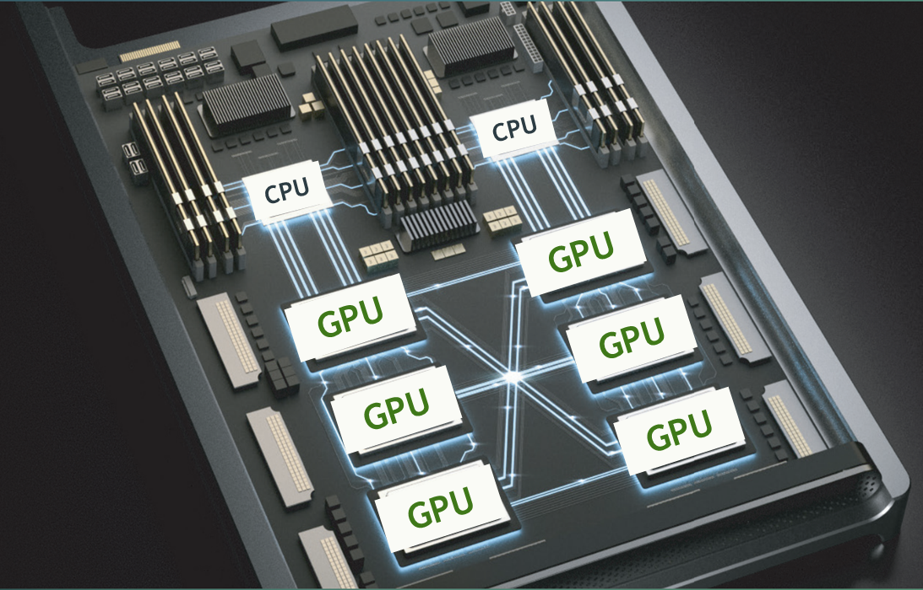
Exascale Architectures
First 66 on Top500 have GPUs!
M
P
M
P
M
Inter-connect
P
M
M
P
P
M
P

Slide 148
Exascale Architectures

Slide 149
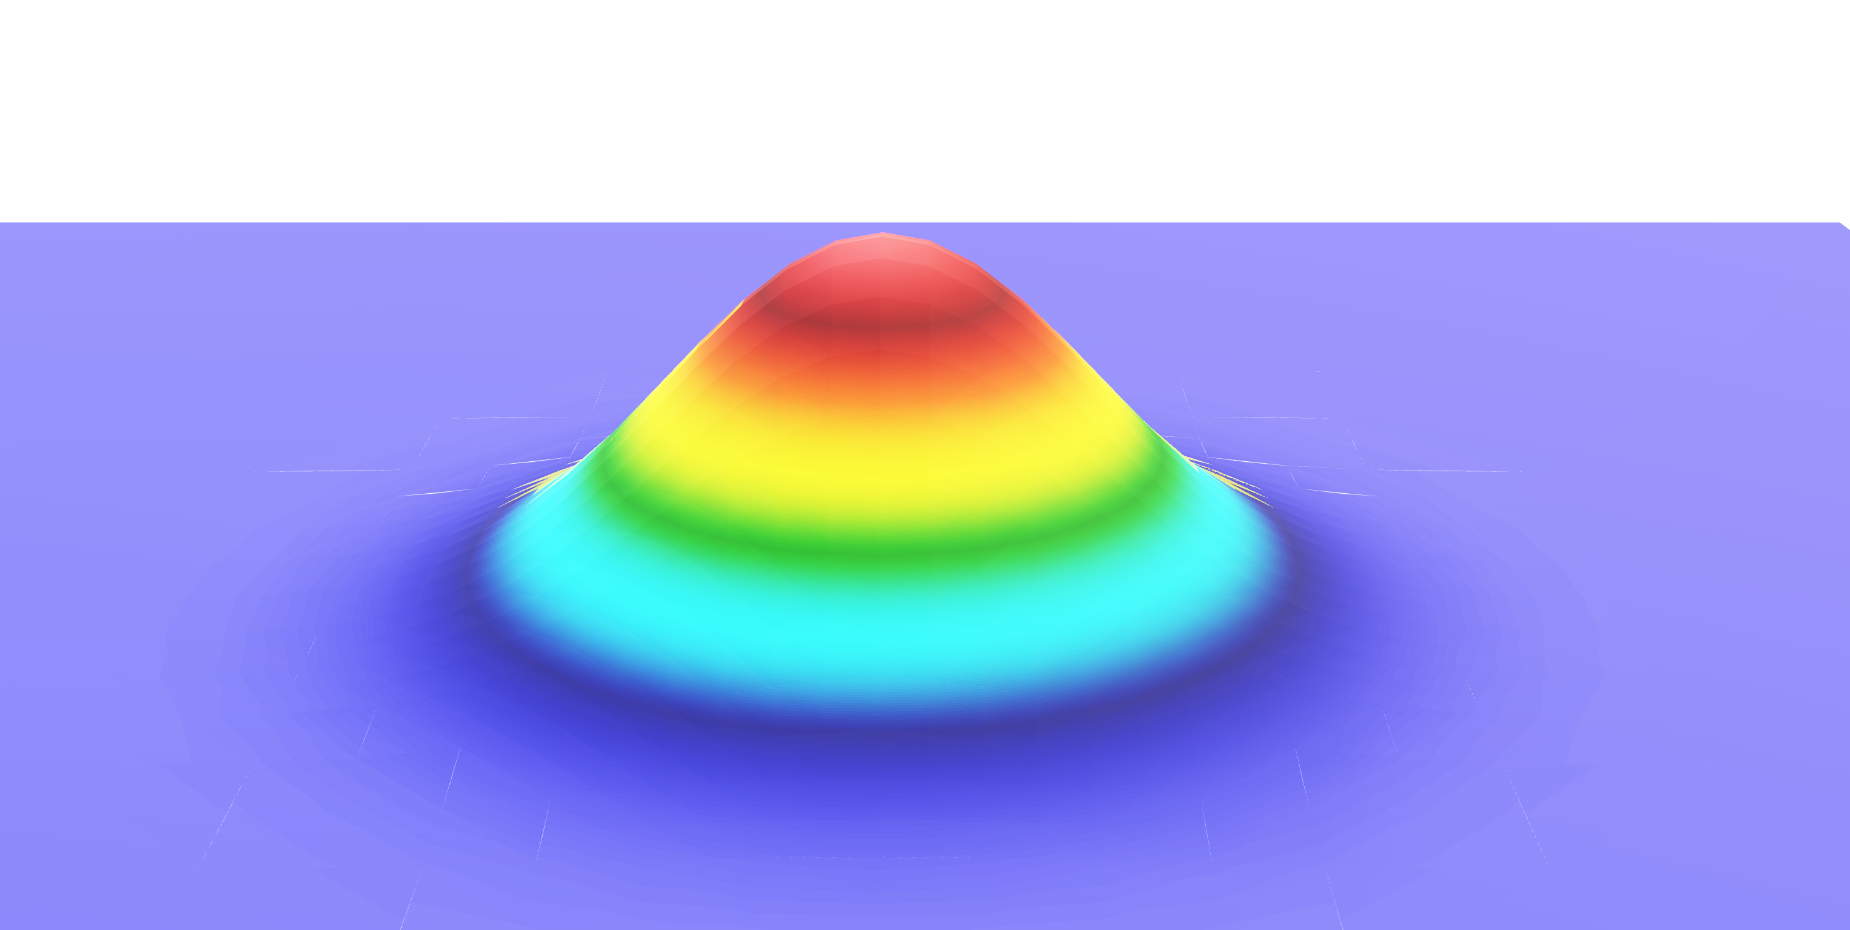

Exascale Architectures
$$−Δu\left(x,y\right)=f$$

Slide 150

MPI + X
$$−Δu\left(x,y\right)=f$$

Slide 151
MPI + X
$$−Δu\left(x,y\right)=f$$

Slide 152
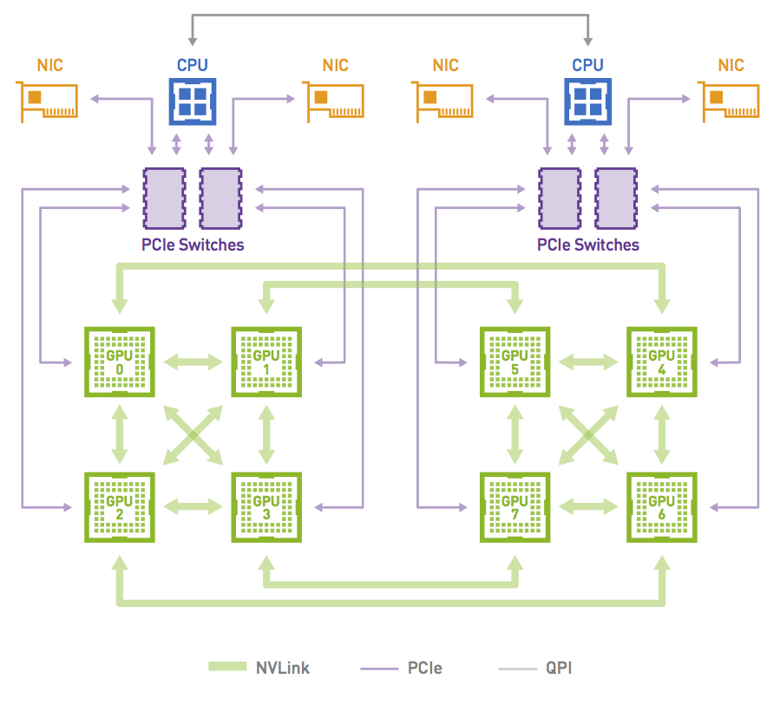
Communication Between GPUs
Naïve Method (staged approach)
1. Copy data from GPU to CPU
2. Use MPI to transfer data CPU to CPU
3. Copy data from CPU to GPU

Slide 153
Communication Between GPUs
GPU-Aware
Copy data from GPU to GPU
Pass device memory pointer in MPI functions!
Must check system if supported

Slide 154

Communication Between GPUs
GPU-Aware
Copy data from GPU to GPU
Pass device memory pointer in MPI functions!
Must check system if supported
Talk to
Daniel Howard!

Slide 155

Hands On Activity #4
Neural Networks on GPUs

Slide 156
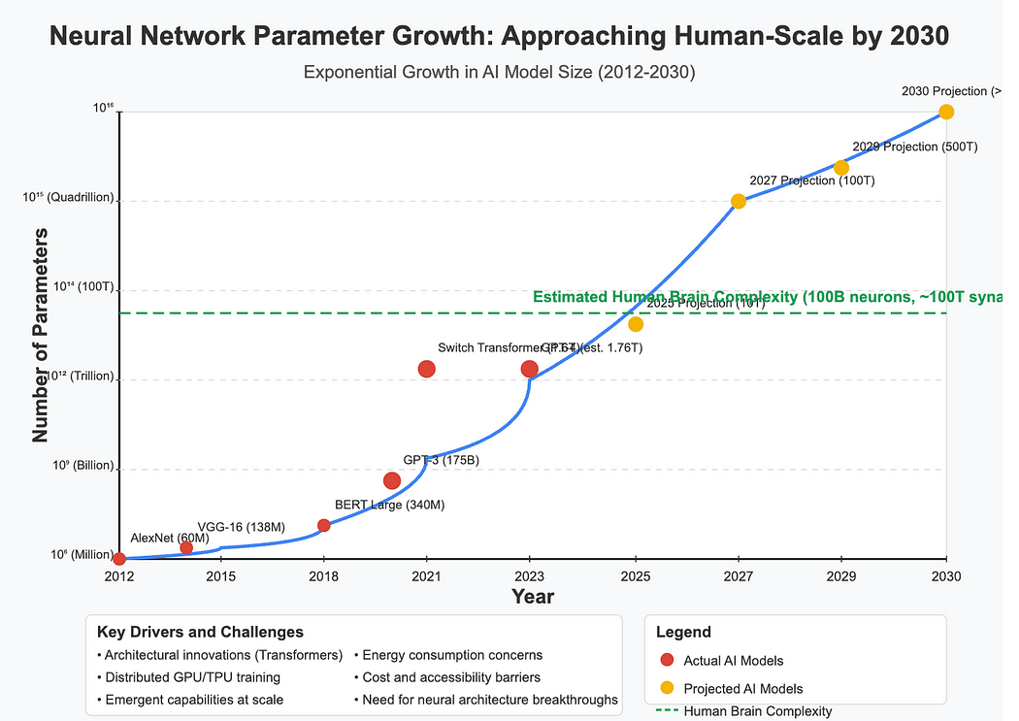
Neural Networks - Trillion Parameters?!
https://medium.com/genusoftechnology/the-10-neural-breakthroughs-coming-by-2030-e460d03ab271

Slide 157
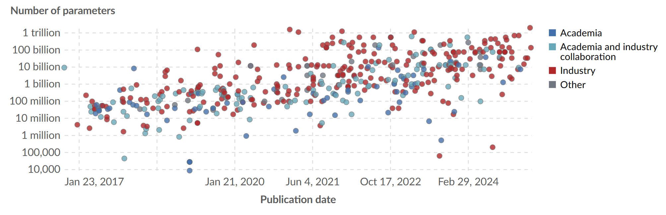
Neural Networks - Trillion Parameters?!
https://ourworldindata.org/grapher/artificial-intelligence-parameter-count?time=2011-11-06..latest

Slide 158
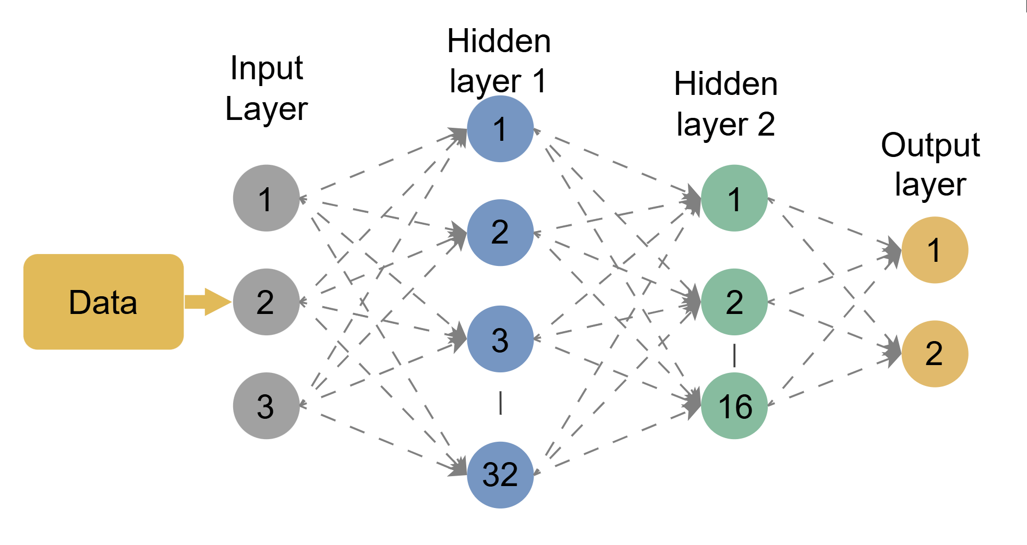

Multi-Layer Perceptron (MLP)

Slide 159
Multi-Layer Perceptron (MLP)
Inputs
Weights
Bias
Parameters

Slide 160

Activation Functions

Slide 161

Deep Neural Network (DNN) Training
https://www.youtube.com/watch?v=MO_CESBOXgo
https://arxiv.org/abs/2104.04473

Slide 162





Parallelizing DNN Training
https://www.youtube.com/watch?v=MO_CESBOXgo
https://arxiv.org/abs/2104.04473

Slide 163

Inter-Layer Model Parallelism
Low throughput due to poor resource utilization
1 |  |  |  |  |  |  |  |  |  | 1 |  | 2 |  |  |  |  |  |  |  |  |  | 2
 | 1 |  |  |  |  |  |  | 1 |  |  |  |  | 2 |  |  |  |  |  |  | 2
 |  | 1 |  |  |  | 1 |  |  |  |  |  |  |  | 2 |  |  |  | 2
 |  |  | 1 | 1 |  |  |  |  |  |  |  |  |  |  | 2 | 2
https://www.youtube.com/watch?v=MO_CESBOXgo
https://arxiv.org/abs/2104.04473

Slide 164
Pipeline Parallelism
A
 |  |  |  | A
 |  |  |  |  |  |  |  | A
 |  |  |  |  |  |  |  |  |  |  |  | A |  |  |  | A
Split batch into microbatches and pipeline execution
https://www.youtube.com/watch?v=MO_CESBOXgo
https://arxiv.org/abs/2104.04473

Slide 165
Pipeline Parallelism
A
 |  |  |  | A
 |  |  |  |  |  |  |  | A
 |  |  |  |  |  |  |  |  |  |  |  | A |  |  |  | A
Split batch into microbatches and pipeline execution
1 |  |  |  |  |  |  |  |  |  | 1
 | 1 |  |  |  |  |  |  | 1
 |  | 1 |  |  |  | 1
 |  |  | 1 | 1
https://www.youtube.com/watch?v=MO_CESBOXgo
https://arxiv.org/abs/2104.04473

Slide 166
Pipeline Parallelism
A
 |  |  |  | A
 |  |  |  |  |  |  |  | A
 |  |  |  |  |  |  |  |  |  |  |  | A |  |  |  | A
Split batch into microbatches and pipeline execution
1 | 2 |  |  |  |  |  |  |  |  | 1 |  |  | 2
 | 1 | 2 |  |  |  |  |  | 1 |  |  | 2
 |  | 1 | 2 |  |  | 1 |  |  | 2
 |  |  | 1 | 1 |  | 2 | 2
https://www.youtube.com/watch?v=MO_CESBOXgo
https://arxiv.org/abs/2104.04473

Slide 167
Pipeline Parallelism
A
 |  |  |  | A
 |  |  |  |  |  |  |  | A
 |  |  |  |  |  |  |  |  |  |  |  | A |  |  |  | A
Split batch into microbatches and pipeline execution
1 | 2 | 3 |  |  |  |  |  |  |  | 1 |  |  | 2 |  |  | 3
 | 1 | 2 | 3 |  |  |  |  | 1 |  |  | 2 |  |  | 3
 |  | 1 | 2 | 3 |  | 1 |  |  | 2 |  |  | 3
 |  |  | 1 | 1 |  | 2 | 2 |  | 3 | 3
https://www.youtube.com/watch?v=MO_CESBOXgo
https://arxiv.org/abs/2104.04473

Slide 168
Pipeline Parallelism
A
 |  |  |  | A
 |  |  |  |  |  |  |  | A
 |  |  |  |  |  |  |  |  |  |  |  | A |  |  |  | A
Split batch into microbatches and pipeline execution
1 | 2 | 3 | 4 |  |  |  |  |  |  | 1 |  |  | 2 |  |  | 3 |  |  | 4
 | 1 | 2 | 3 | 4 |  |  |  | 1 |  |  | 2 |  |  | 3 |  |  | 4
 |  | 1 | 2 | 3 | 4 | 1 |  |  | 2 |  |  | 3 |  |  | 4
 |  |  | 1 | 1 |  | 2 | 2 |  | 3 | 3 |  | 4 | 4
https://www.youtube.com/watch?v=MO_CESBOXgo
https://arxiv.org/abs/2104.04473

Slide 169
Pipeline Parallelism
A
 |  |  |  | A
 |  |  |  |  |  |  |  | A
 |  |  |  |  |  |  |  |  |  |  |  | A |  |  |  | A
Can we
be clever?
Split batch into microbatches and pipeline execution
1 | 2 | 3 | 4 |  |  |  |  |  |  | 1 |  |  | 2 |  |  | 3 |  |  | 4 |  | 5 | 6
 | 1 | 2 | 3 | 4 |  |  |  | 1 |  |  | 2 |  |  | 3 |  |  | 4 |  |  |  |  | 5 | 6
 |  | 1 | 2 | 3 | 4 | 1 |  |  | 2 |  |  | 3 |  |  | 4 |  |  |  |  |  |  |  | 5
 |  |  | 1 | 1 |  | 2 | 2 |  | 3 | 3 |  | 4 | 4
https://www.youtube.com/watch?v=MO_CESBOXgo
https://arxiv.org/abs/2104.04473

Slide 170
Pipeline Parallelism
A
 |  |  |  | A
 |  |  |  |  |  |  |  | A
 |  |  |  |  |  |  |  |  |  |  |  | A |  |  |  | A
Split batch into microbatches and pipeline execution
1 | 2 | 3 | 4 |  |  |  |  |  |  | 1 |  | 5 | 2 |  | 6 | 3 |  | 7 | 4 |  | 8 | 5
 | 1 | 2 | 3 | 4 |  |  |  | 1 |  |  | 2 |  | 5 | 3 |  | 6 | 4 |  | 7 | 5 |  | 8 | 6
 |  | 1 | 2 | 3 | 4 | 1 |  |  | 2 |  |  | 3 |  | 5 | 4 |  | 6 | 5 |  | 7 | 6 |  | 8
 |  |  | 1 | 1 |  | 2 | 2 |  | 3 | 3 |  | 4 | 4 |  | 5 | 5 |  | 6 | 6 |  | 7 | 7
https://www.youtube.com/watch?v=MO_CESBOXgo
https://arxiv.org/abs/2104.04473

Slide 171

Inter-Layer Model Parallelism
https://www.youtube.com/watch?v=MO_CESBOXgo
https://arxiv.org/abs/2104.04473

Slide 172
Inter-Layer Model Parallelism
A
 |  |  |  | A
 |  |  |  |  |  |  |  | A
 |  |  |  |  |  |  |  |  |  |  |  | A |  |  |  | A
Any more ideas?
Split batch into microbatches and pipeline execution
1 | 2 | 3 | 4 |  |  |  |  |  |  | 1 |  | 5 | 2 |  | 6 | 3 |  | 7 | 4 |  | 8 | 5
 | 1 | 2 | 3 | 4 |  |  |  | 1 |  |  | 2 |  | 5 | 3 |  | 6 | 4 |  | 7 | 5 |  | 8 | 6
 |  | 1 | 2 | 3 | 4 | 1 |  |  | 2 |  |  | 3 |  | 5 | 4 |  | 6 | 5 |  | 7 | 6 |  | 8
 |  |  | 1 | 1 |  | 2 | 2 |  | 3 | 3 |  | 4 | 4 |  | 5 | 5 |  | 6 | 6 |  | 7 | 7
https://www.youtube.com/watch?v=MO_CESBOXgo
https://arxiv.org/abs/2104.04473

Slide 173

Exercise.4 Pipeline Multi-GPU Parallelism
Input Data
Living Area
Number of bedrooms
Number of bathrooms
Age of
Parking Spaces
Number of Floors
Land Lot Size
Distance to City
Neighborhood Crime Rate
School Rating
Has pool?
Has fireplace?
Neighborhood Code
Year Renovated
Predicting Housing Prices
182,945 Parameters
Step 1: cd exercises/Exercise.4-Hybrid/
Step 2: Complete “TODO” tasks in mpiMGR_ASSIGNMENT.py
SOLUTIONS: cd exercises/Exercise.4-Hybrid/.soln
173

Slide 174
FINAL TAKEAWAYS
What we learned:
Review of Message Passing Concepts
MPI Derived Datatypes and Custom Operations
MPI Virtual Topologies
MPI Neighborhood Collectives
Hybrid-Parallel Programming

